Slide 1


Gliding Over HPC Barriers with the Transformative Power of Open OnDemand and Containers Bio-data Club Feb 20, 2025 Mehmet Belgin, PhD Shane Corder Jarett Deangelis Scientific Computing & Research IT

Slide 2


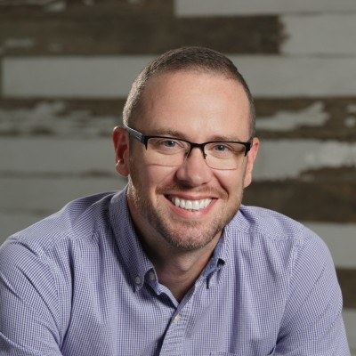

Our Team
We are HPC enthusiasts, passionate about providing Moffitt with unparalleled advantages that set us apart from other research institutions.
Jarett DeAngelis
Director
jarett.deangelis@moffitt.org
Mehmet Belgin, PhD
Sr HPC Systems Eng.
mehmet.belgin@moffitt.org
Shane Corder
Sr HPC Systems Eng.
shane.corder@moffitt.org

Slide 3
In this talk…
Overcoming the Steep Learning Curve: Utilize Open OnDemand (OOD) and containers to navigate the complexities of HPC.
Demonstrating Possibilities: While this is not a formal training session, it gets close by showing what you can achieve and how.
Encouraging Engagement:
Explore and Utilize: Incrementally incorporate these tools into your research.
Reconsider Containers: Give containers a second chance, especially if past experiences were less than favorable.
Overall Goal: Empower all users, from beginners to experts, to effectively utilize HPC resources.
Our focus: Sky is the limit
(not this HPC mountain)

Slide 4
PART I: Open OnDemand (OOD)

Slide 5

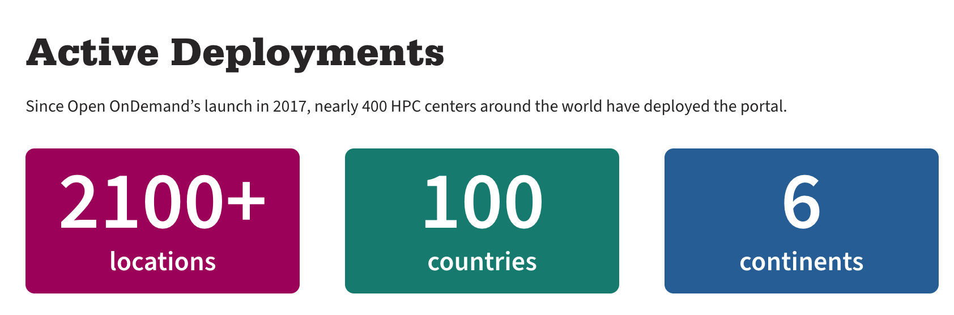
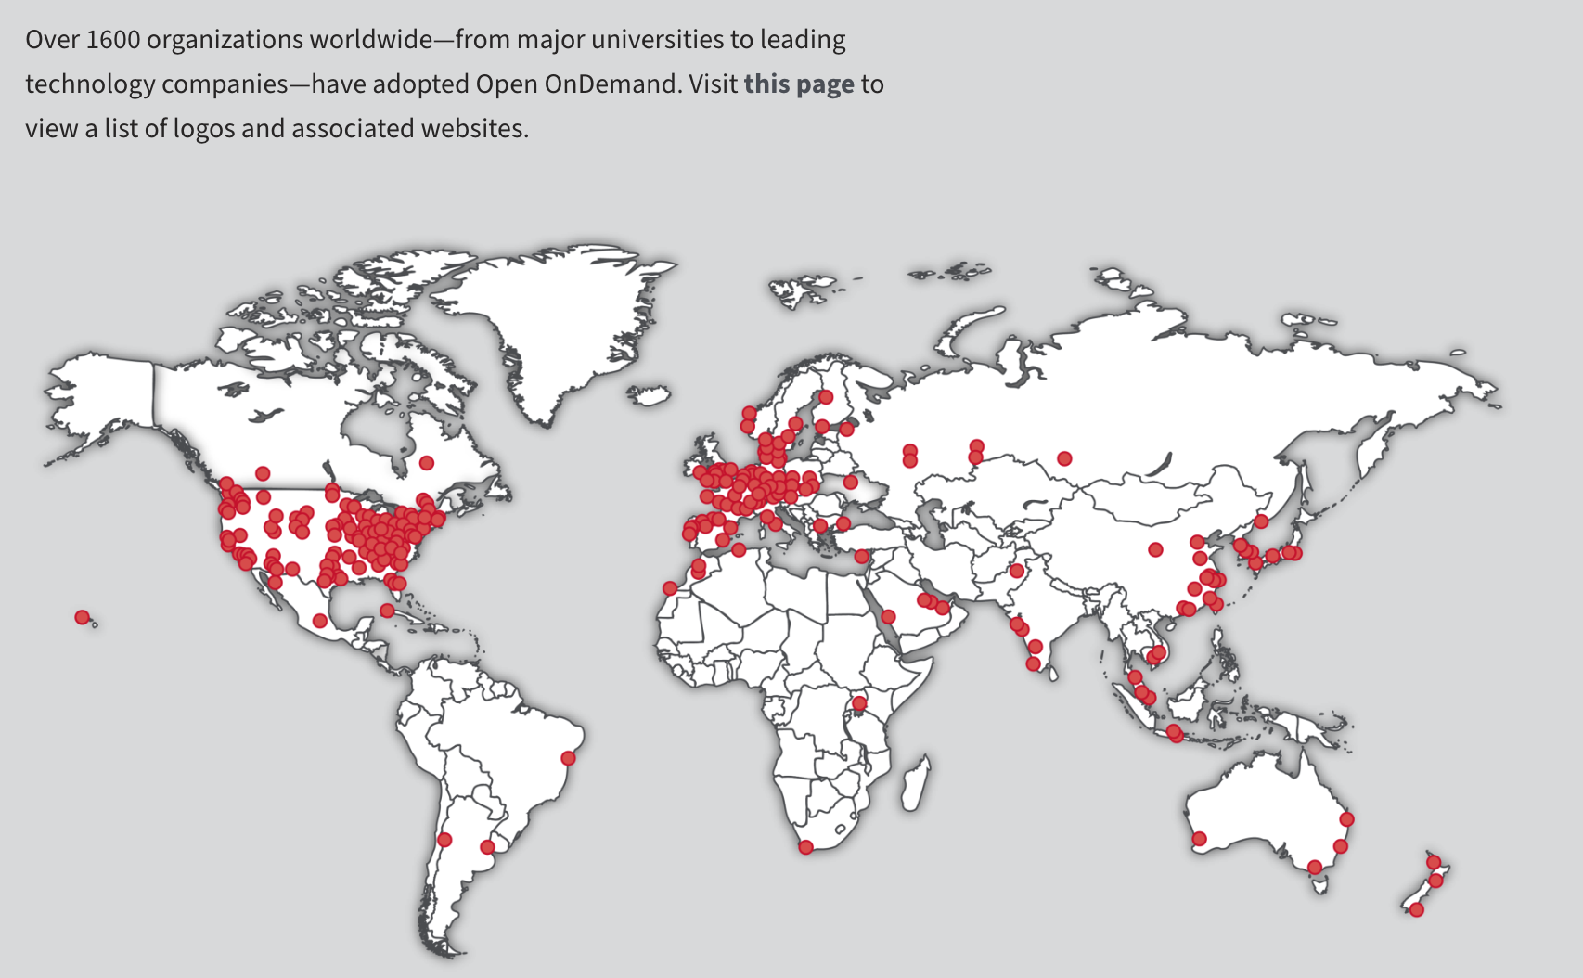
What’s ?
Open OnDemand (OOD) is an open-source web-based platform designed to provide a user-friendly interface for high-performance computing (HPC) clusters. It’s developed by Ohio Supercomputing Center (OSC).

Slide 6
What does Open OnDemand Offer?
Web-based interfaces: Access job submission, file management, and application launching through a web browser.
Job management: Submit, monitor, and manage HPC jobs without requiring any scheduler knowledge or direct terminal access.
File browser: Interact with files on the HPC cluster, upload/download data, and manage directories.
SSH Terminal: Secure access to the cluster through an integrated SSH terminal in the browser.
Interactive apps: Launch and interact with graphical applications, such as Jupyter lab/Notebooks or R Studio, directly in the browser.
Full Desktop access: Launch and interact with a full Linux Desktop for GUI applications with GPU access
Customizable: Can be extended with additional applications and custom configurations for specific research needs.

Slide 7
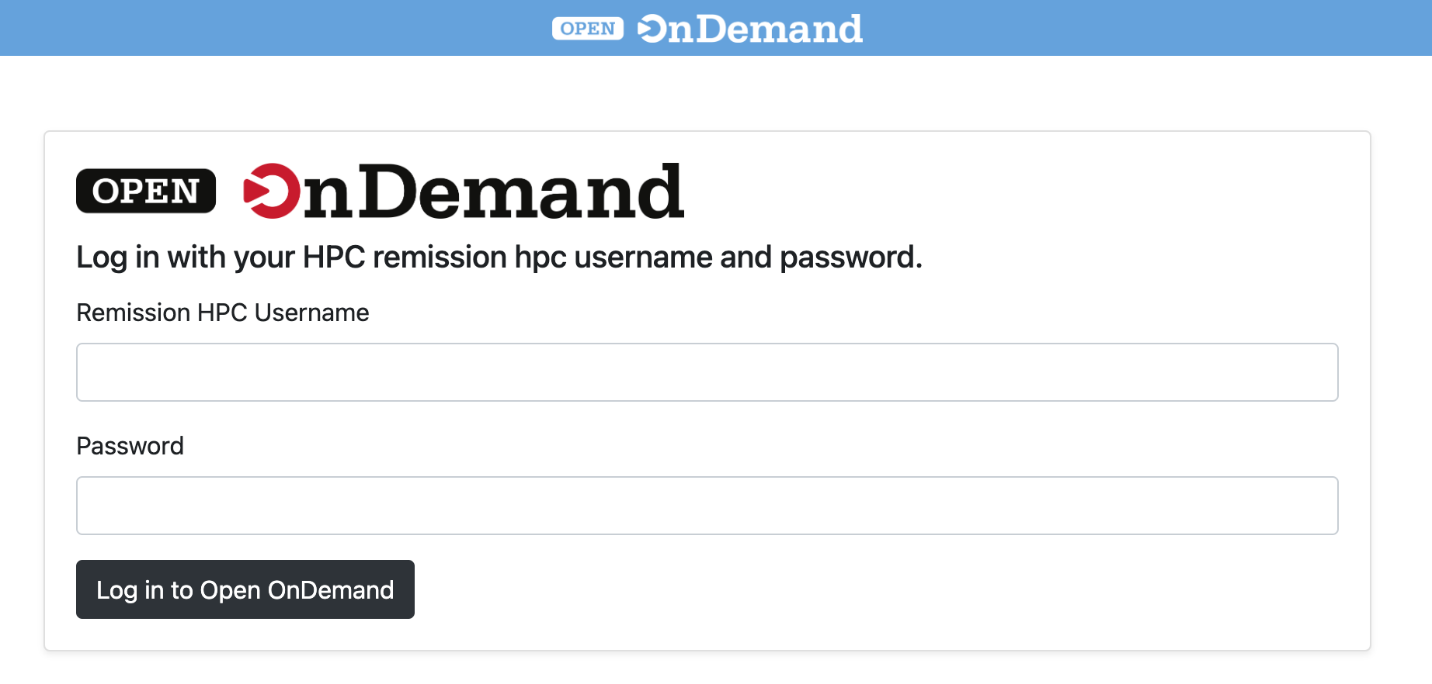
Open OnDemand at Moffitt
Brought to you by Shane Corder’s hard work (round of applause please)
Red Cluster: In production!
https://ood-red.moffitt.org/
Remission Cluster: Beta (but very close to production)
https://ood-remission.moffitt.org/
Needs Moffitt Network/VPN and Moffitt credentials

Slide 8
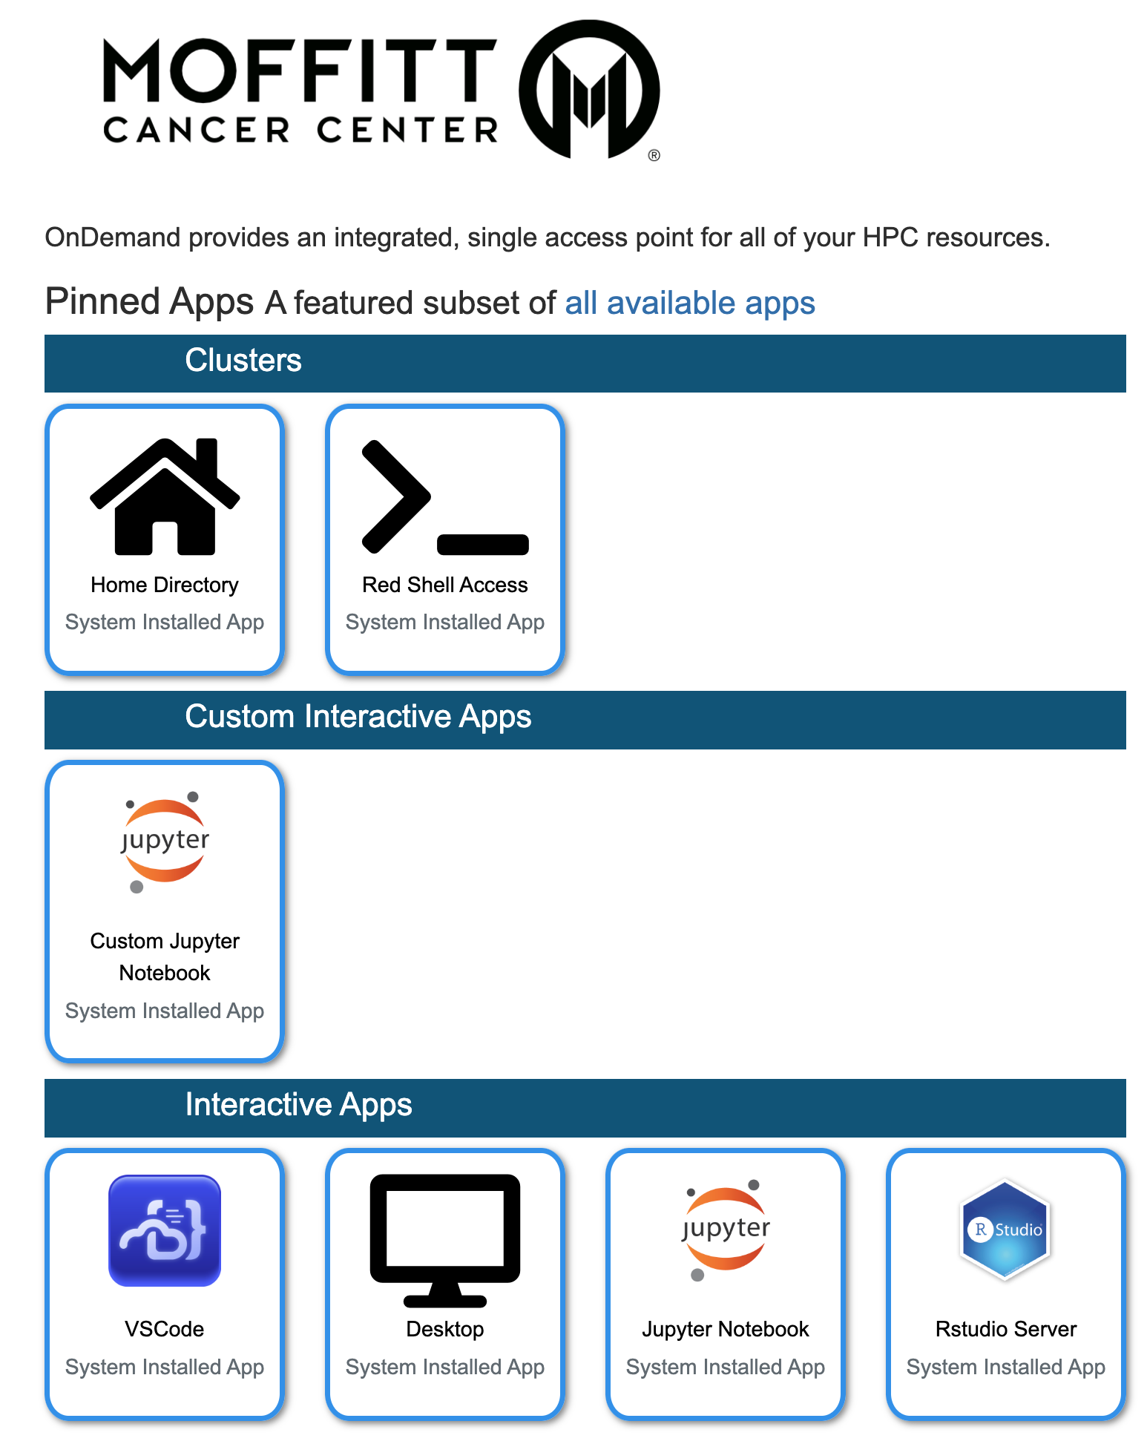
What does OOD look like at Moffitt?
File Browser
Shell Access
Customized Jupyter Notebook
(knows your python envs)
Full Desktop!!
Interactive Apps
VSCode
Jupyter lab / notebook
R Studio Server

Slide 9
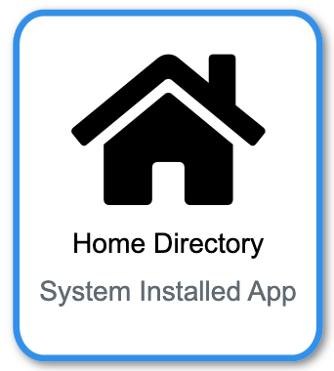
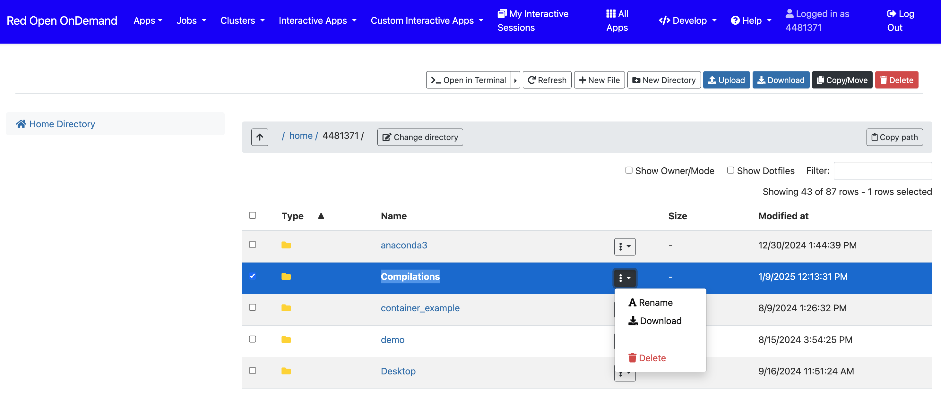
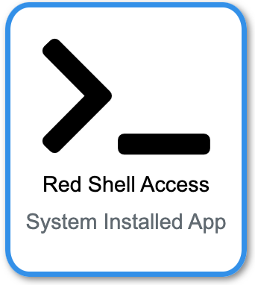
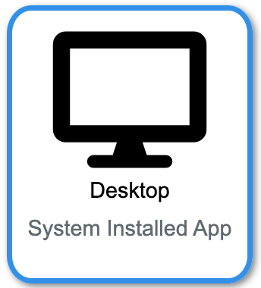
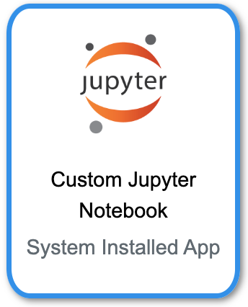
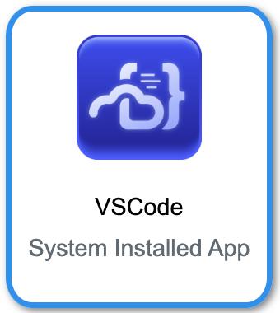
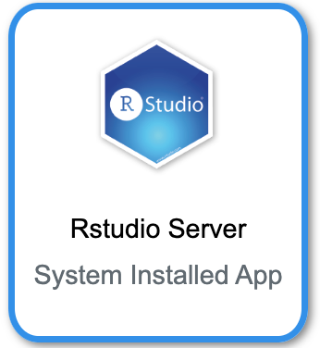
Demo Time!
File Browser

Slide 10
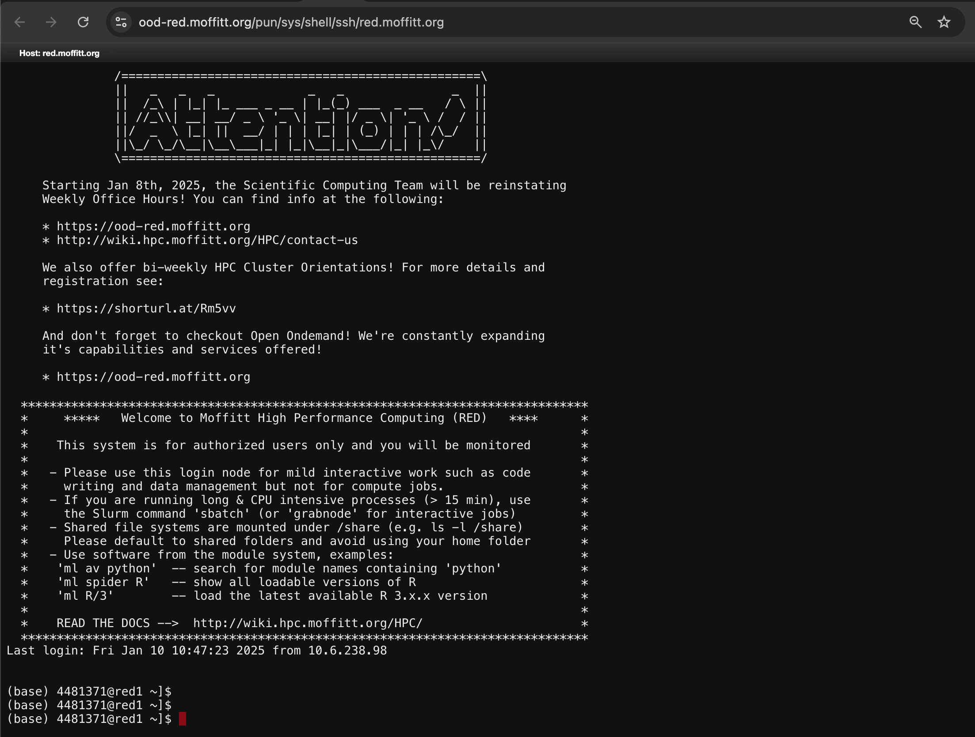
Demo Time!
Shell Access

Slide 11
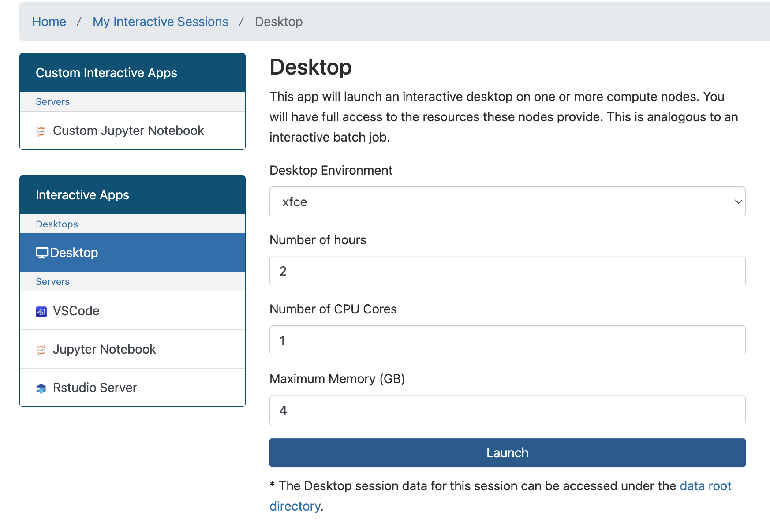
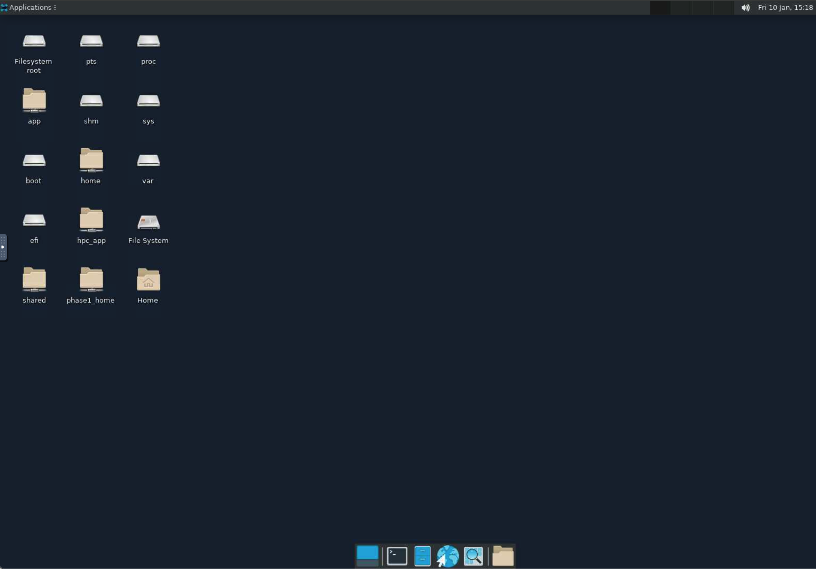
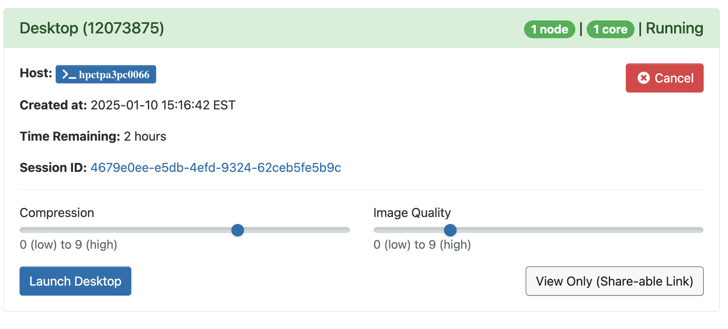
Demo Time!
Full Desktop

Slide 12
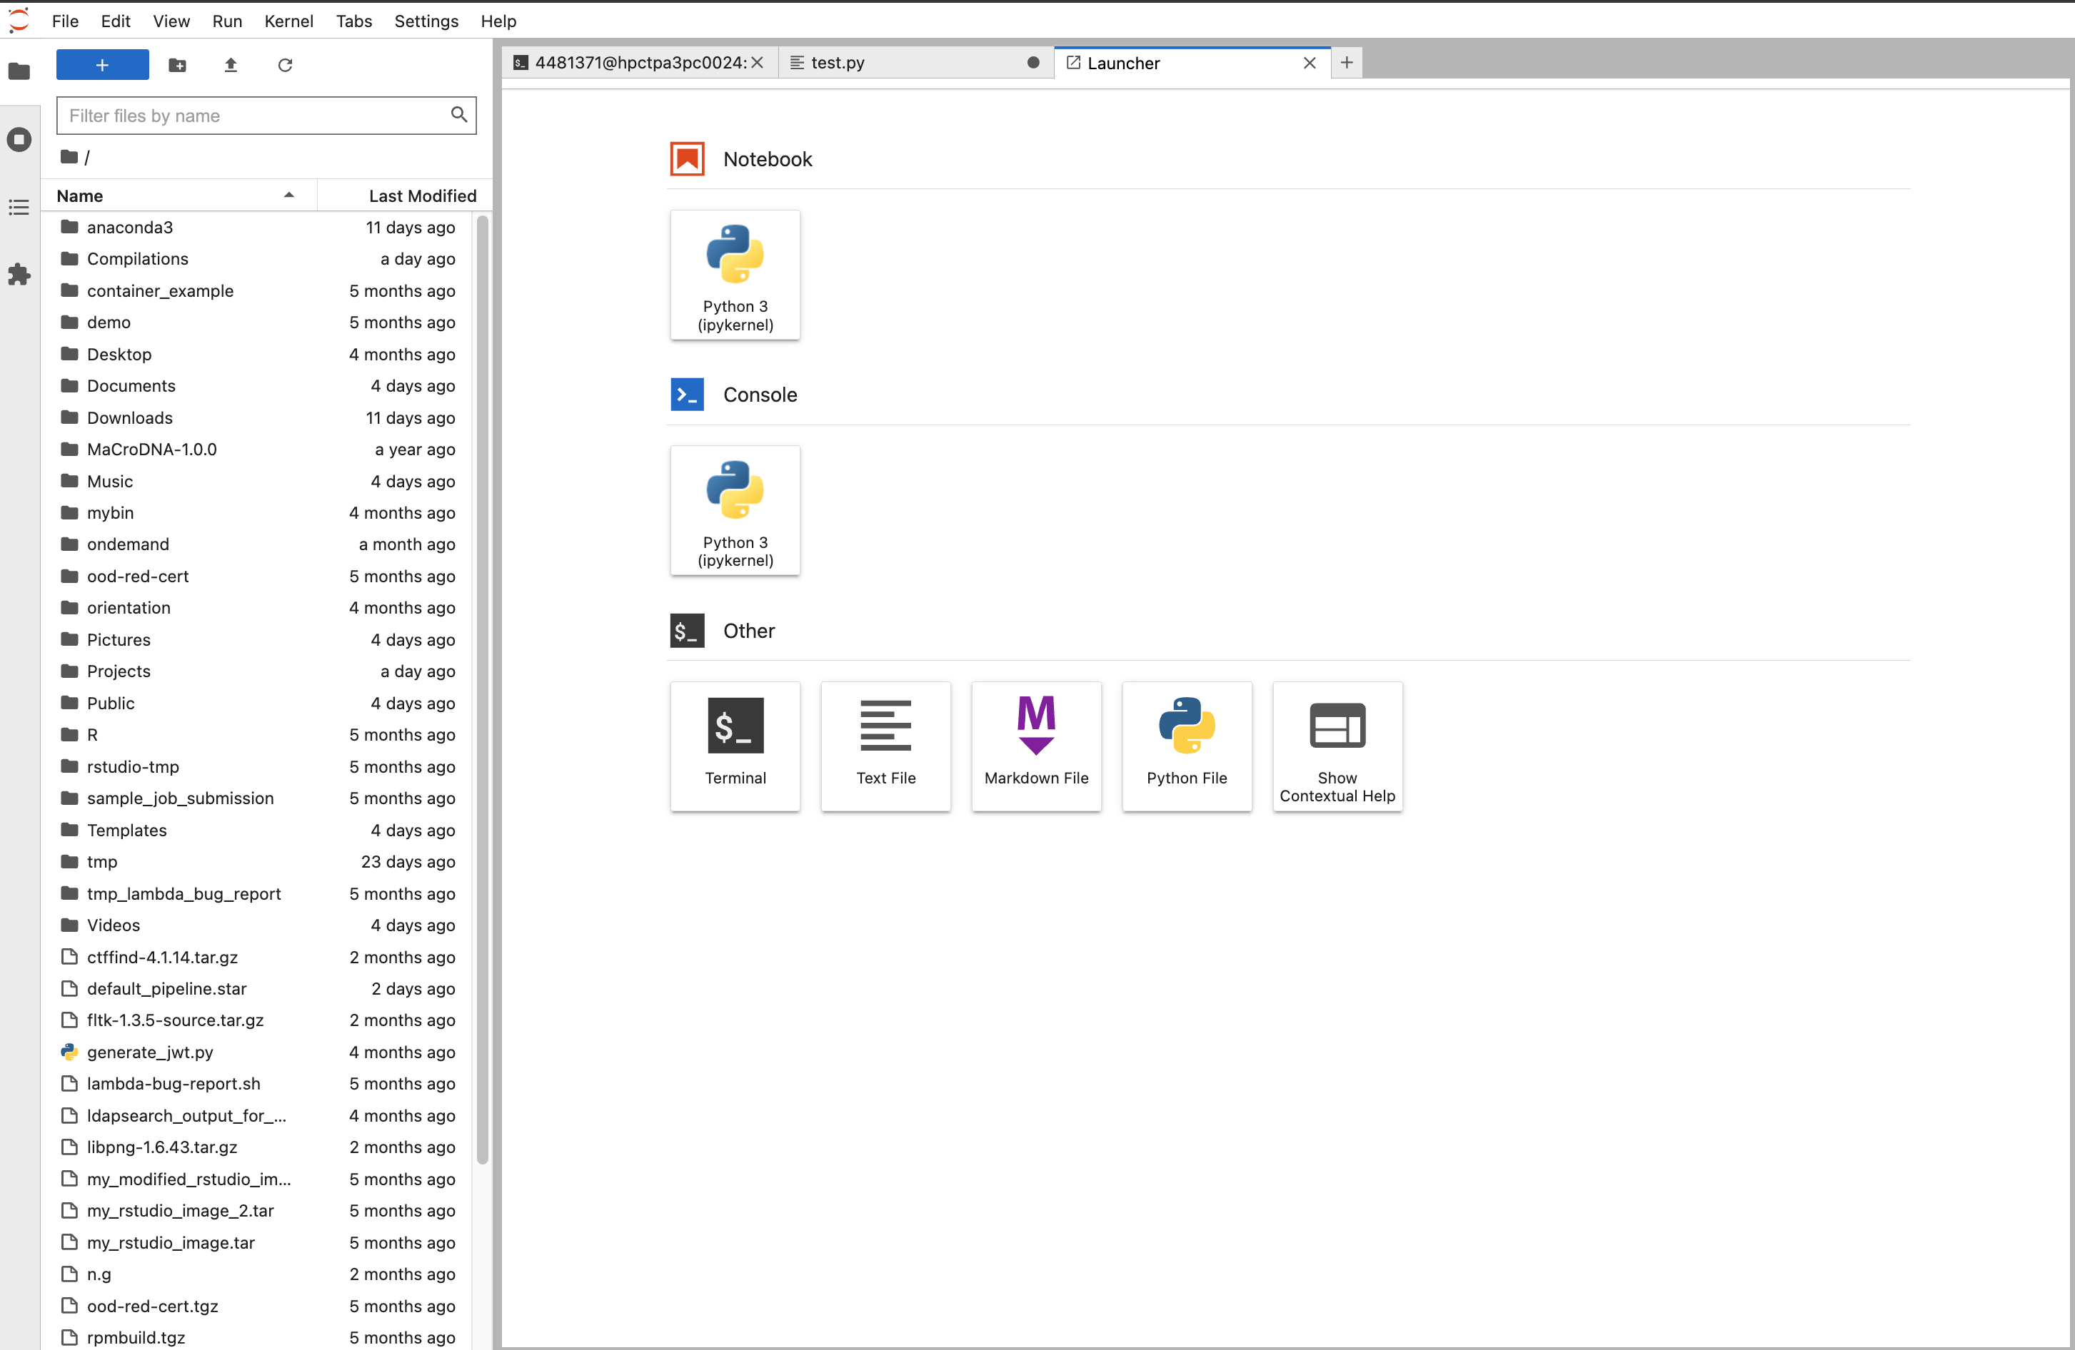
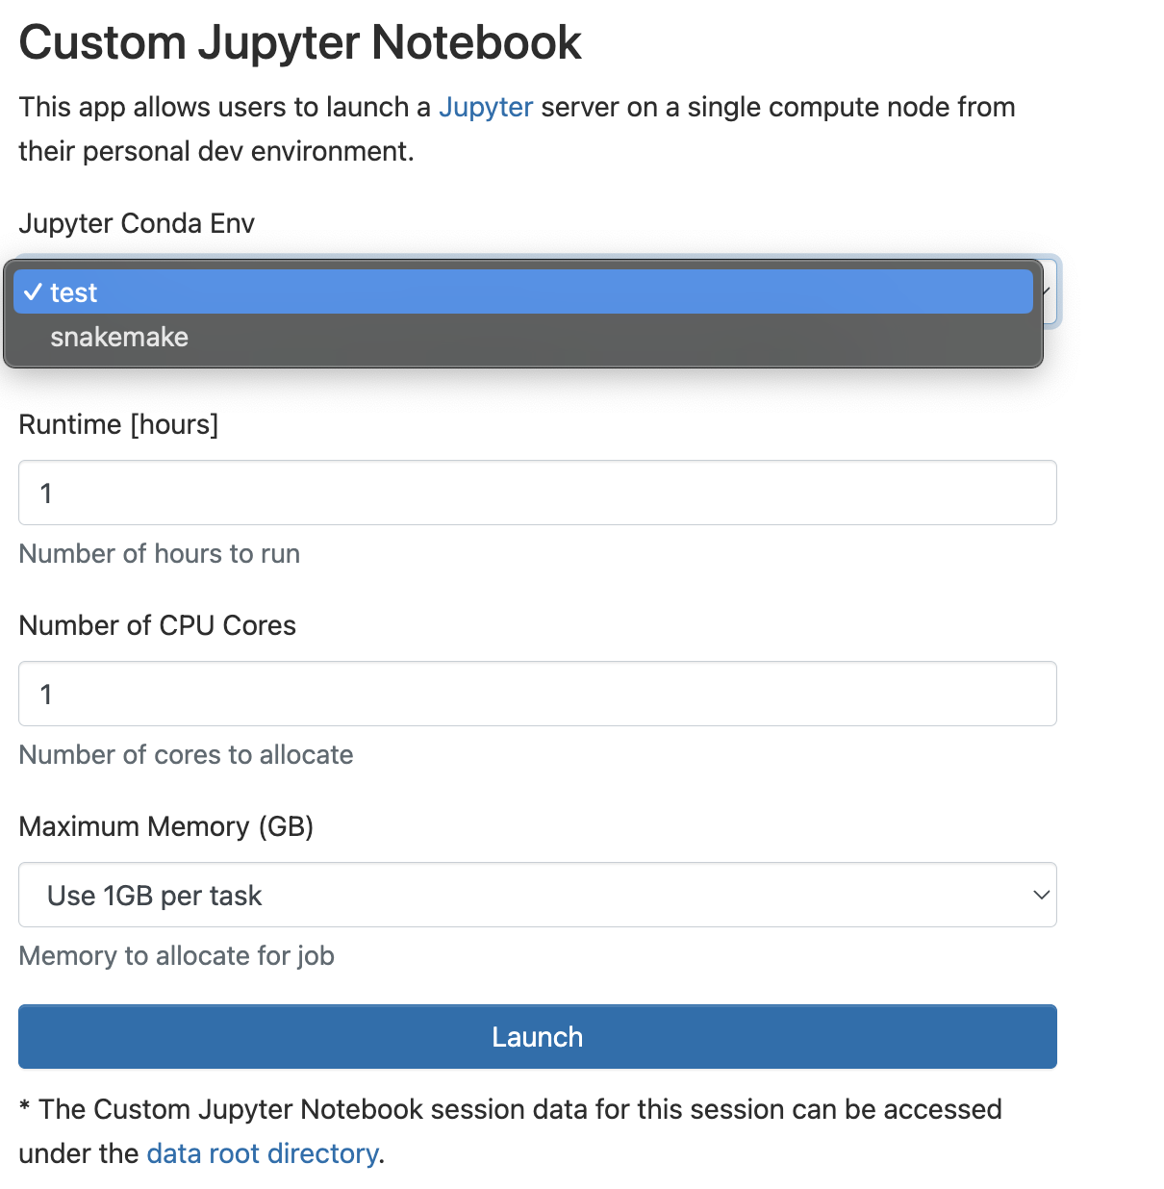
Demo Time!
Custom Jupyter Notebook / Lab (supports user-specific python/conda enviroments)

Slide 13
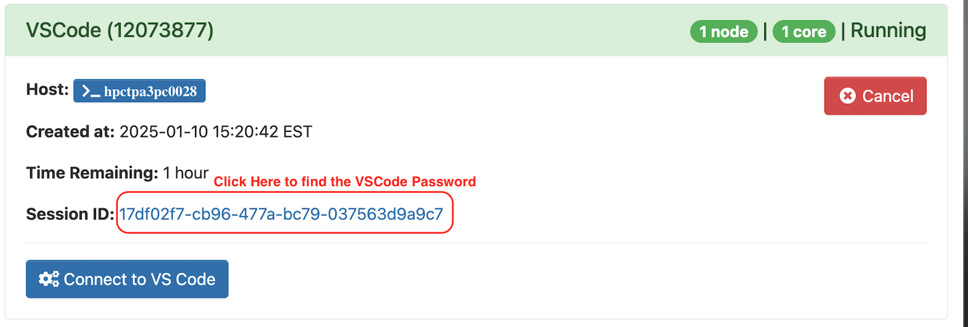
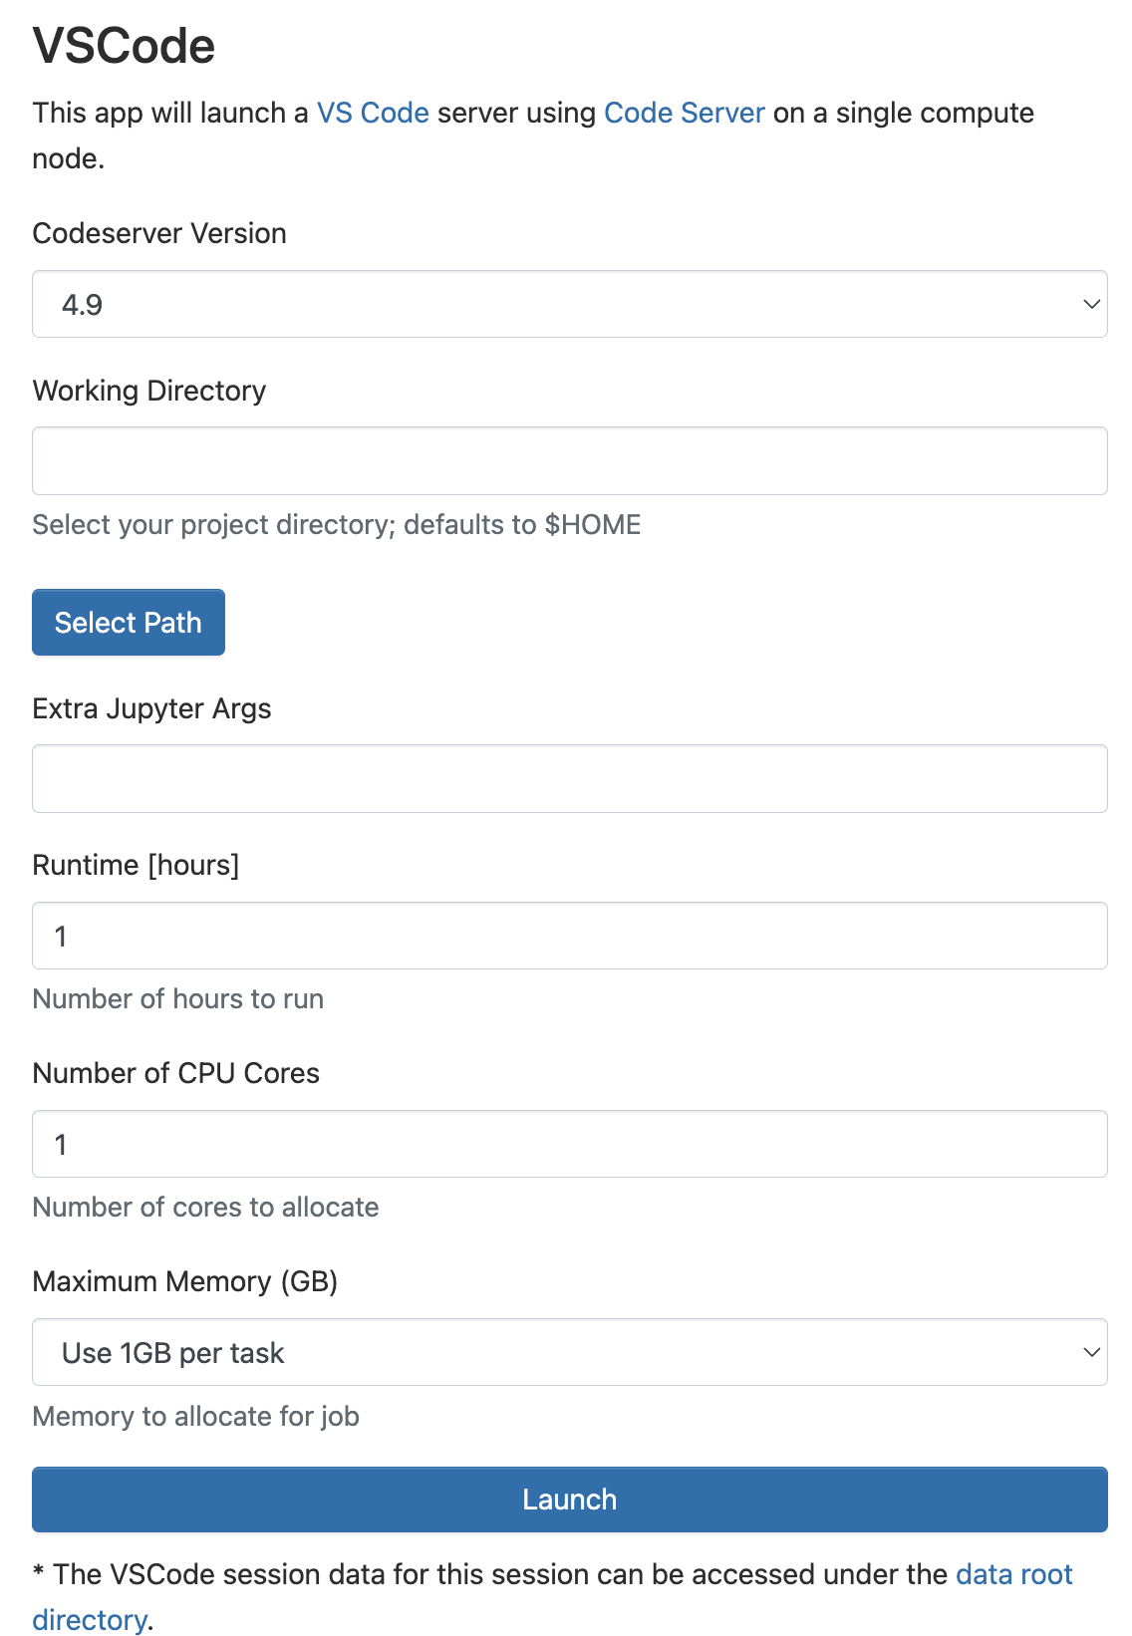
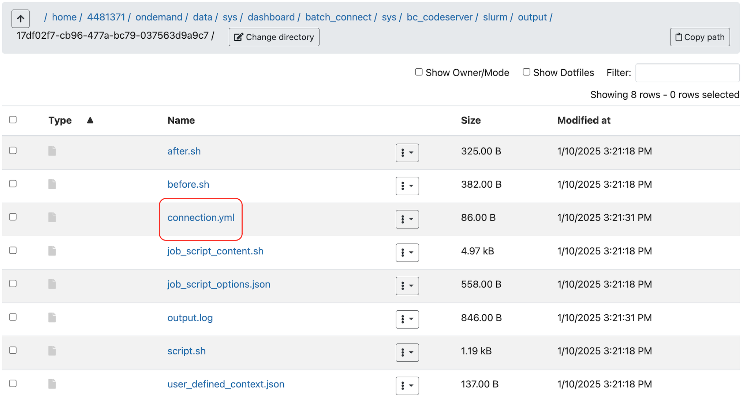
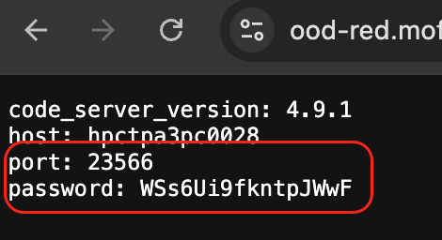
Demo Time!
VSCode
How to find your session password

Slide 14
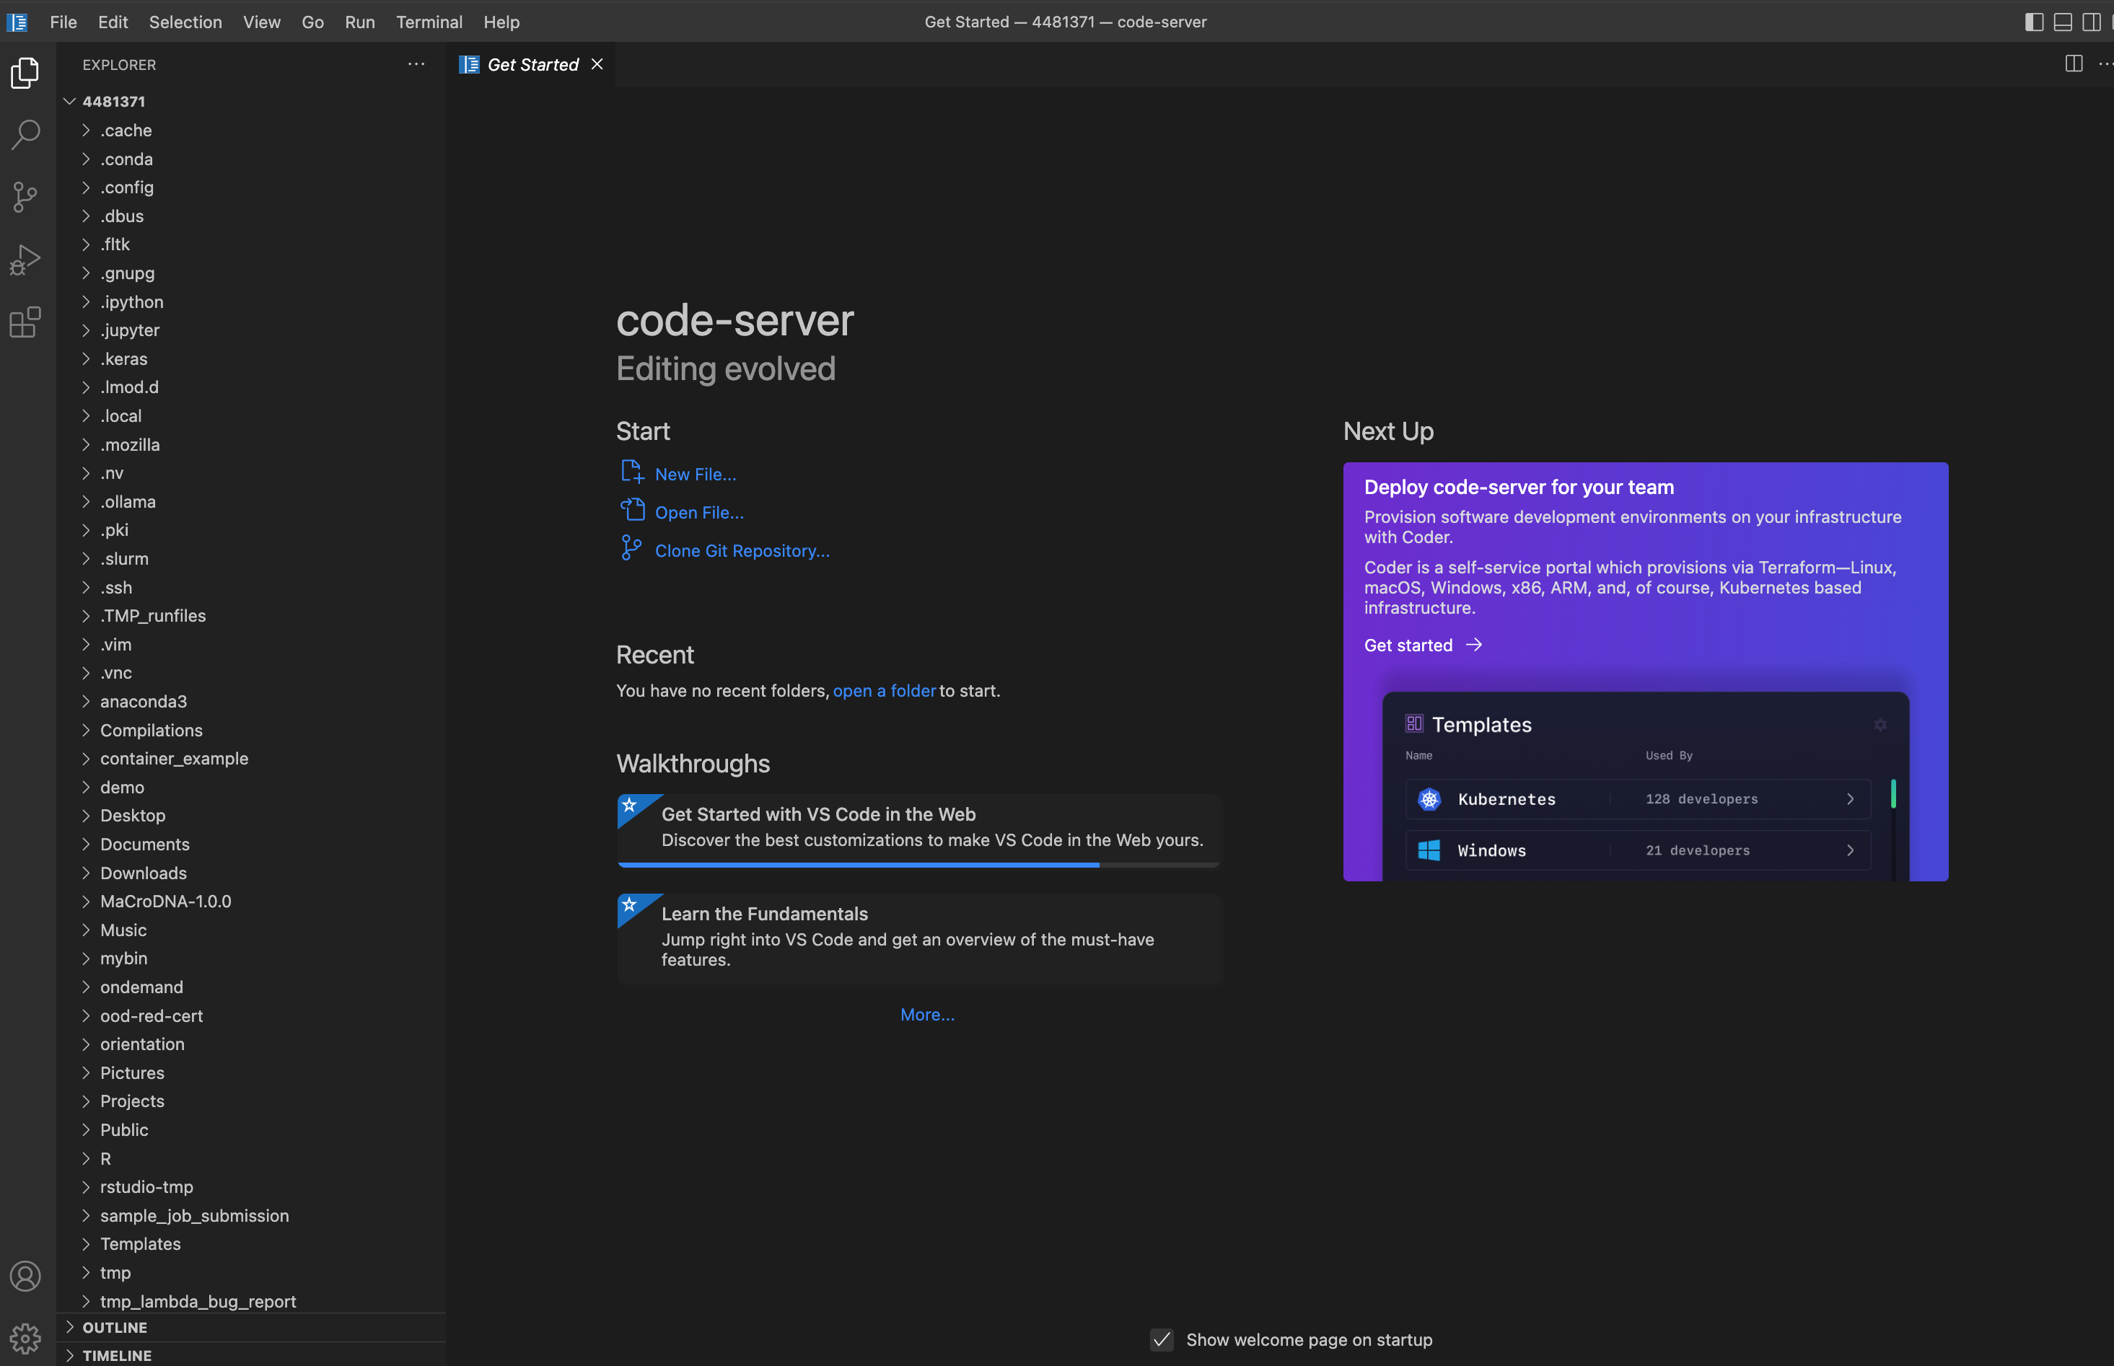
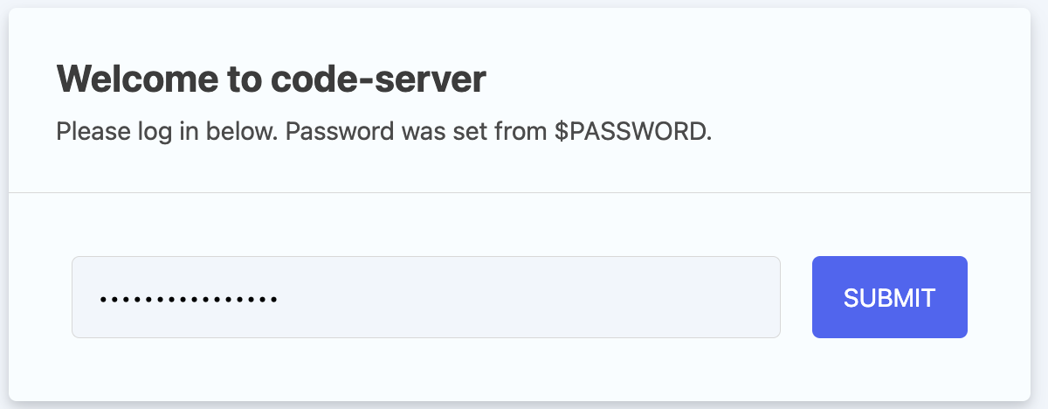
Demo Time!
VSCode

Slide 15
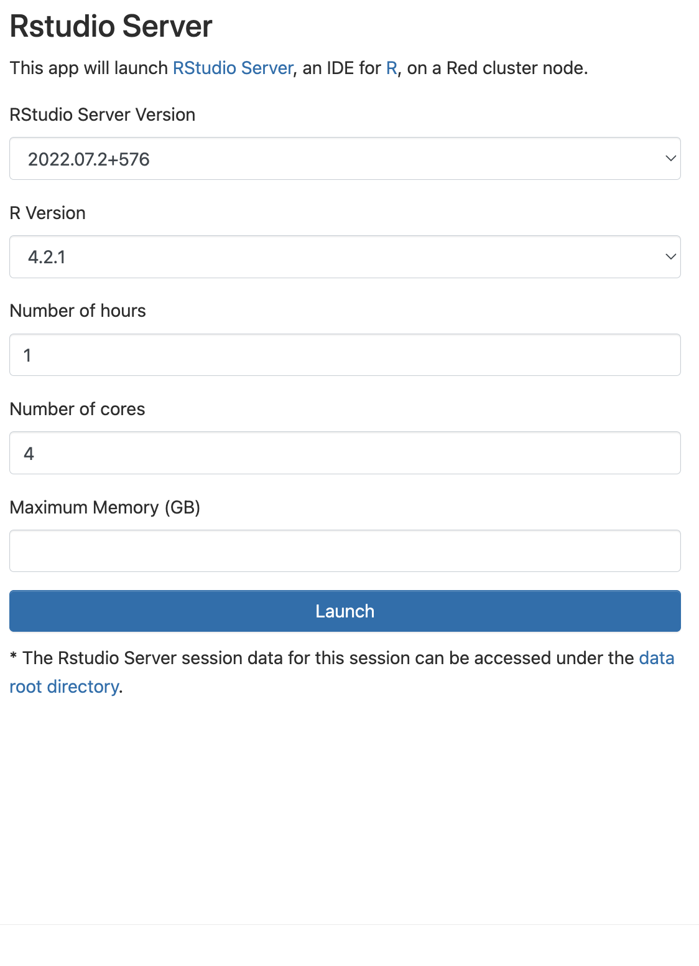
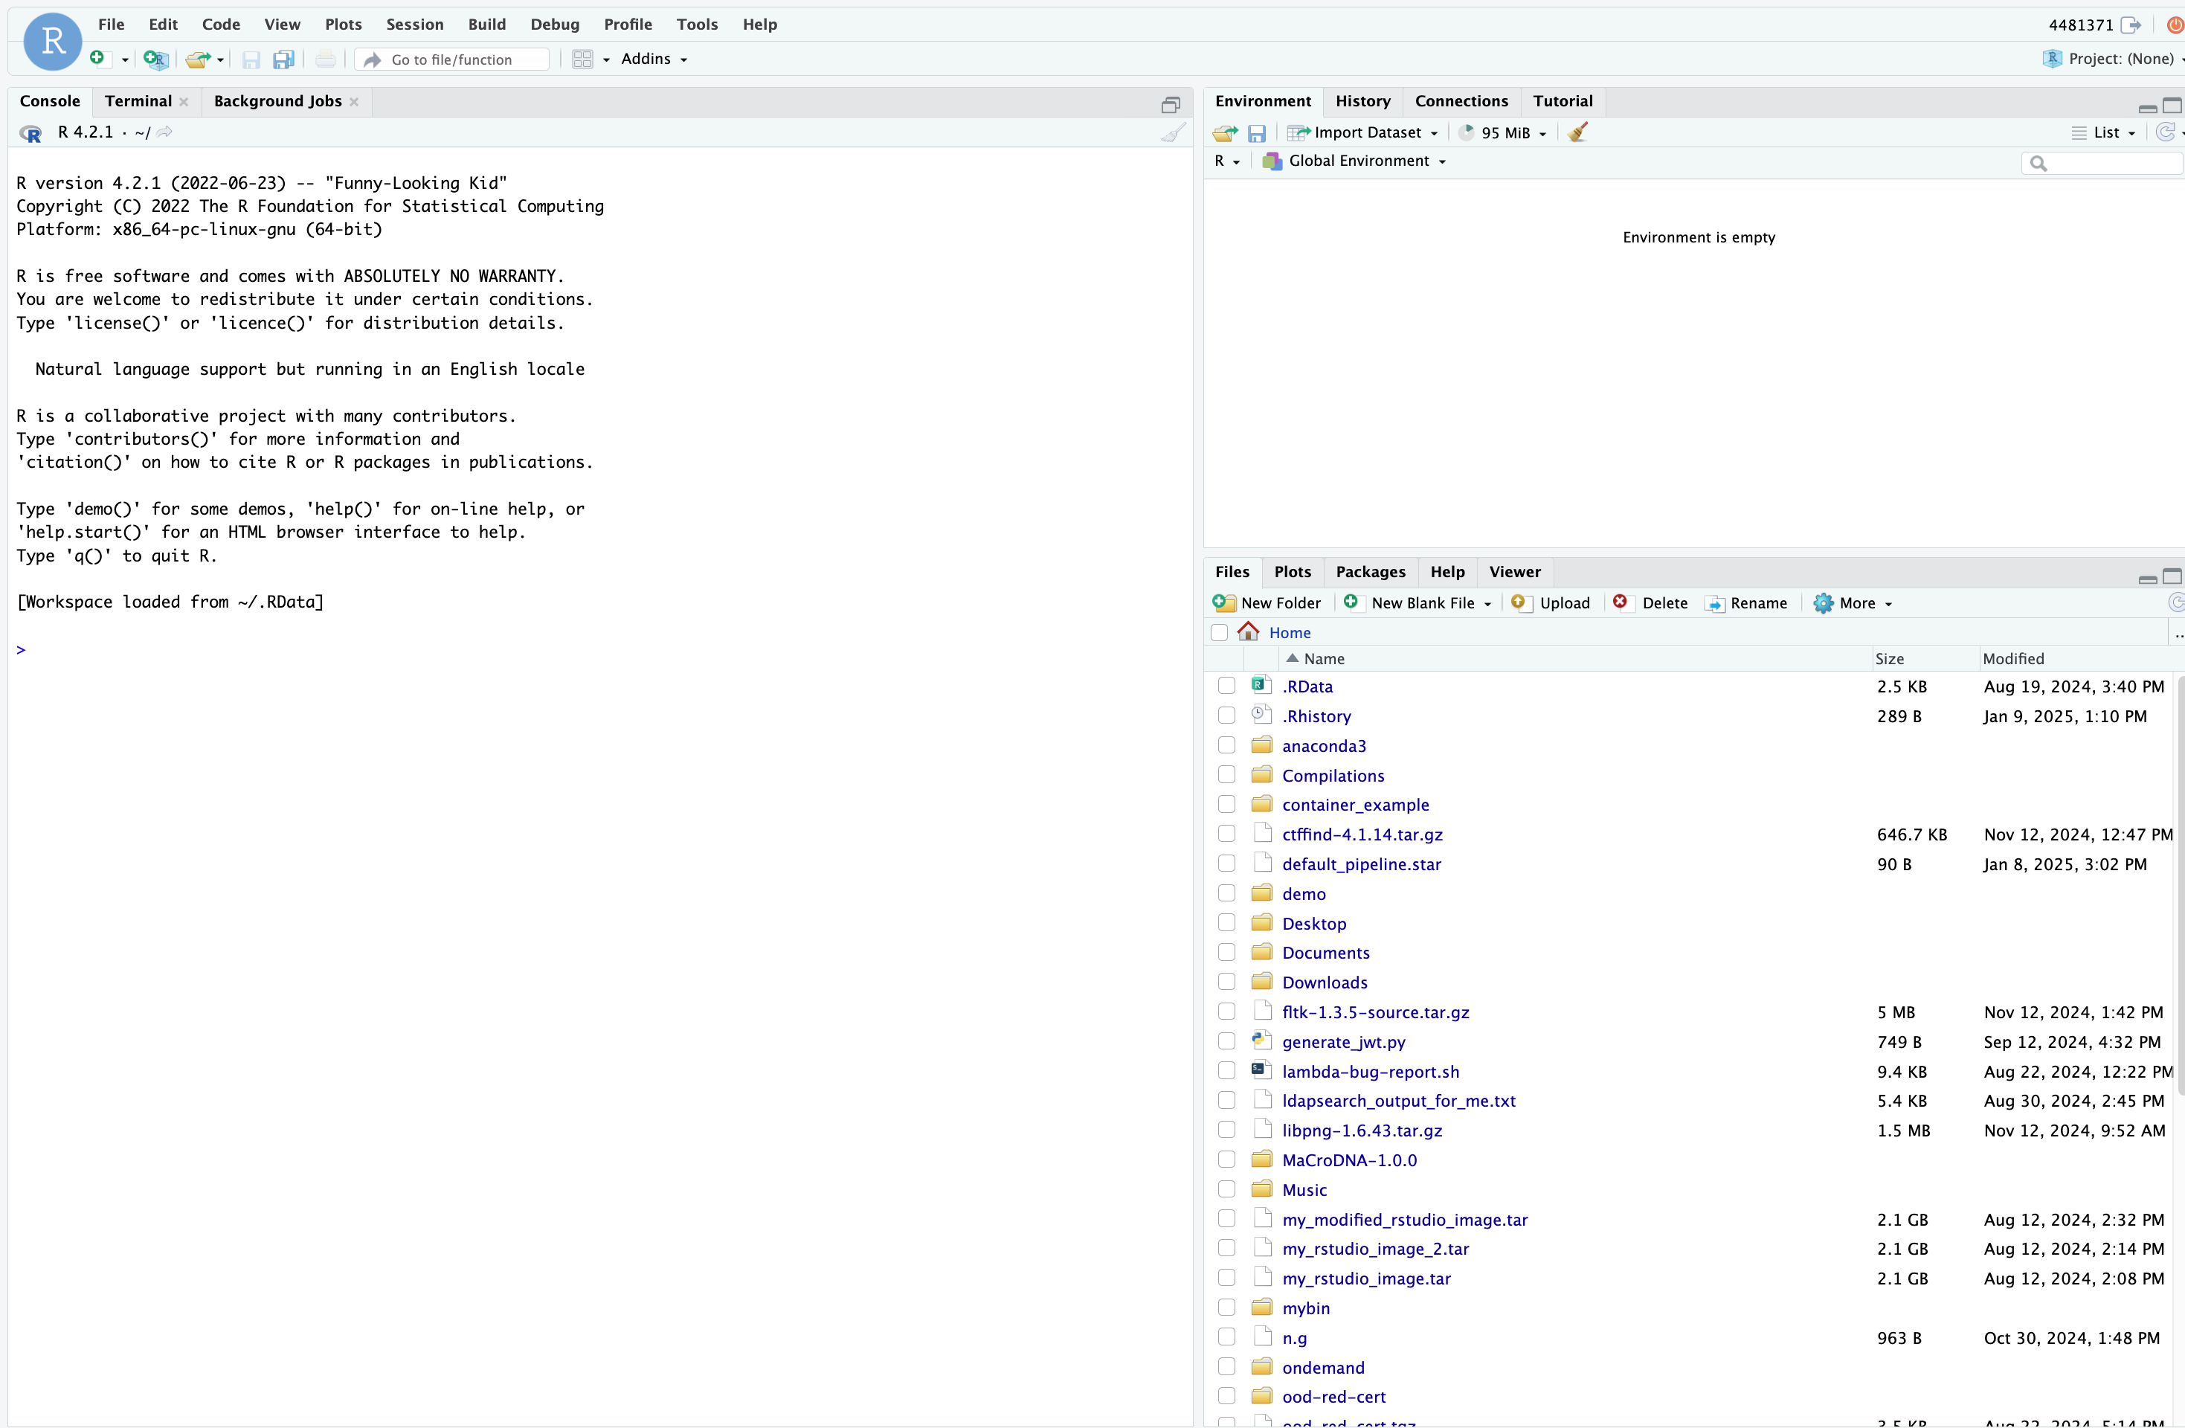
Demo Time!
Rstudio Server

Slide 16
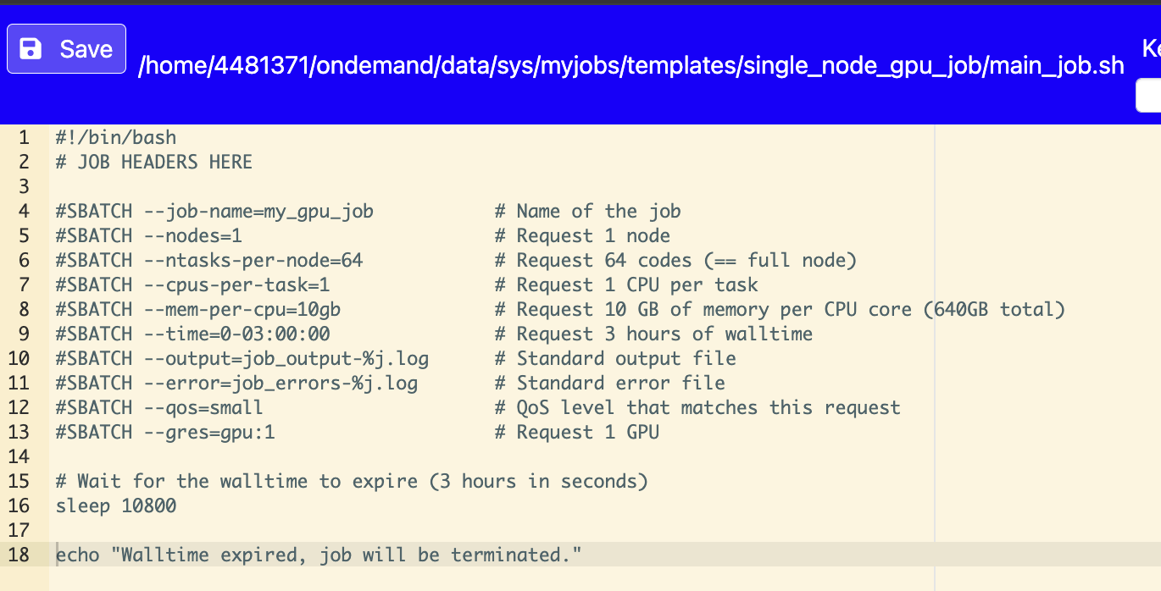
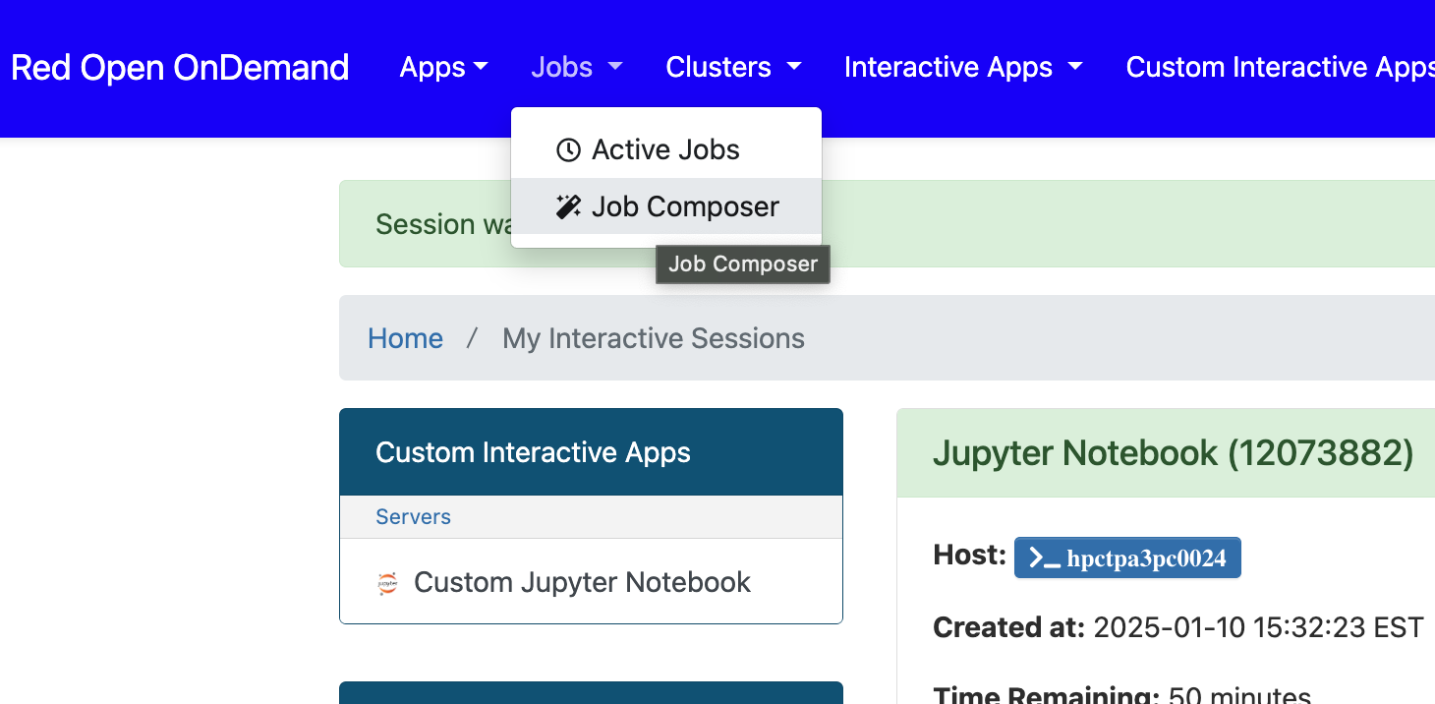
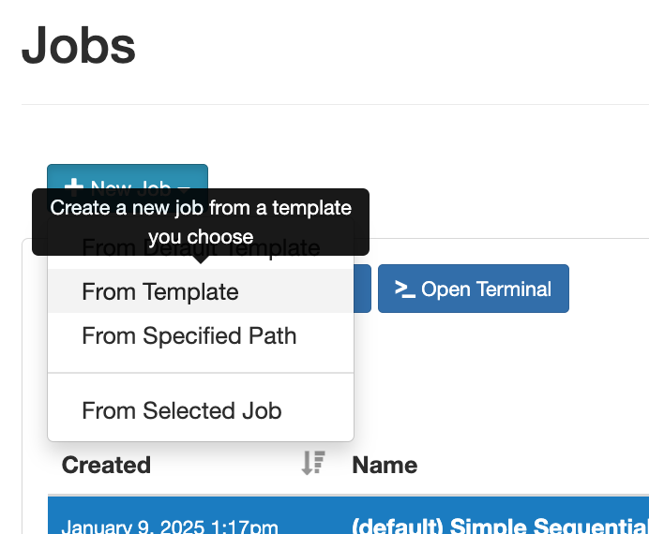
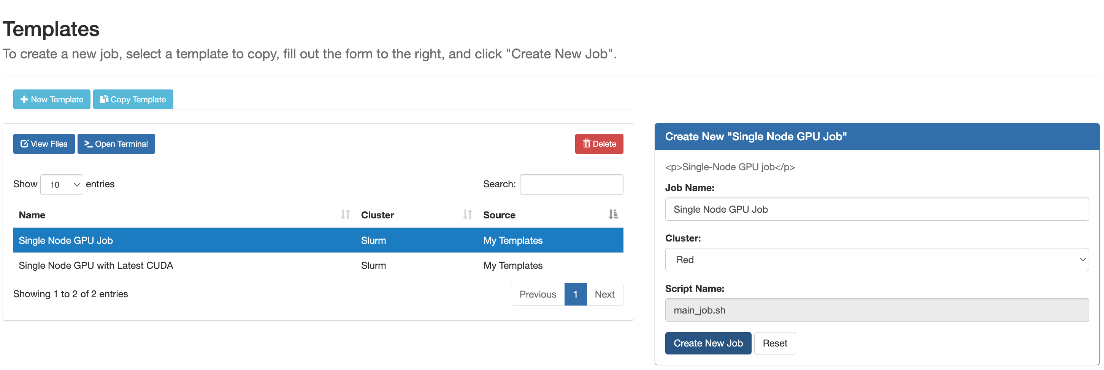
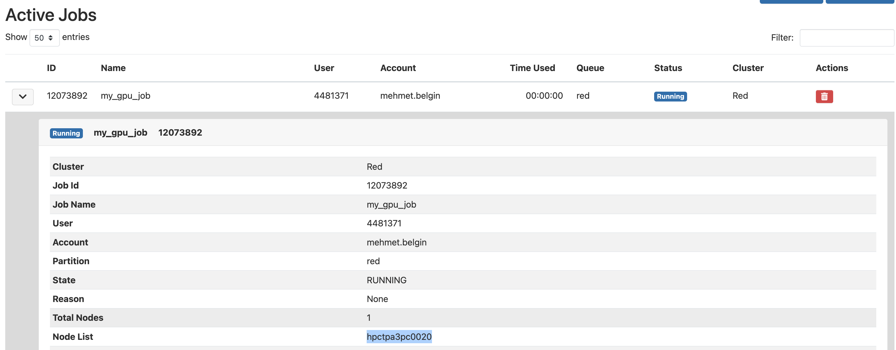
Demo Time!
Job Composer
Step 1
Step 2
You can edit this main_job.sh file to run about anything.
Here, I use the ‘sleep’ command as a trick to make this batch job mimic an interactive job so I can login to the allocated node using SSH for the duration of this allocation (using OOD’s Shell Access!)
You can learn the hostname for a running job using the Jobs -> Active Jobs -> Expand the Job details
Step 3

Slide 17
PART II: Containers

Slide 18
Containers: They are Your Friend!
Do you need….
The latest and greatest versions and libraries that are not available on the system?
A way to run things that working for “everyone else” but not for you? Are they too busy to help you?
Software / Utilities that are NOT supported by the OS and libraries on the cluster?
‘root’ privileges to setup your workflows and software?
Provide your colleagues and peers with a way to consistently replicate your research results?
Running the same applications on the HPC Cluster, your lab machines and your personal devices with ease?
Store your research workflow for the future, making sure it’ll still work on future architectures?
… list goes on!!
In one sentence:
Containers are an extremely useful technology, well worth of the time investment you need to master them.

Slide 19
Containers: Let’s bust some myths
Myth #1: They are difficult to learn and use
No, they are not – especially given how well they are documented with excellent tutorials/videos online
Myth #2: They come with a performance penalty
True: they *may* incur some overhead, but not even noticeable in most cases
Also True: you can use many expert-optimized containers from vendors with a significant performance boost!
Containers can access system components (CPU, GPU) via passthrough options as if they are running natively
Myth #3: They are like “black boxes” – you can only use them for the purpose they are built for
Partially true: Yet, most containers offer root level shell access == freedom to add/change whatever you like!
It’s extremely easy to start with a base container and create your own – but in most cases you don’t have to
Myth #4: Containers require compatible hardware
Partially true: modern containers offer emulation support with impressive results.
E.g. I have a x86/Ubuntu ‘jupyter lab’ container which works seamlessly on an Apple M3 laptop and Windows 11
Myth #5: They can get huge and require a lot of storage!!
This one is quite true, yet good practices mitigate this issue significantly
Store images – not each container instances (== run with ‘--rm’ to remove container instances after running)
Use repositories (e.g. dockerhub, harbor) to park (and share!) unused images ← More on this later
Create hybrid containers that do multiple things for you – instead of one container for each task

Slide 20

Using Software Containers at Moffitt
We support Docker, Podman and Apptainer (a.k.a Singularity).
Moffitt runs a private DockerHub-like platform (Harbor) https://dockerhub.moffitt.org/
Login using Moffitt credentials
You can create private/public projects, pull/push containers, share with other Moffitt users.
We recommend Using Podman: allows you to create, run, and manage containers and container images without requiring a daemon like Docker. Its interface is identical to Docker.
The benefit of building with Podman is its use of standard OCI format which is much more widely used than Apptainer’s sif. It makes them easier to share with systems that only support Docker or other OCI-based technologies (which is very common).

Slide 21
Basic Podman Container Management
Purpose | Command | Example
Search for a container | podman search | podman search rstudio
Pull a container as an image | podman pull | podman pull rocker/rstudio
List pulled images | podman images | podman images
Delete a pulled image | podman rmi <IMAGEID> | podman rmi d96a50ac4757
List containers | podman ps [-a to list stopped] | podman ps -a
Run/Stop a pulled container | podman run <IMAGEID> (or name) podman stop <ContainerID> | podman run d96a50ac4757 podman stop e8aae4b3c645
Execute command | podman exec –t <IMAGEID> command | podman exec -it d96a50ac4757 /bin/bash
Purpose | Argument | Example
Run in detached mode | -d | podman run \ -e PASSWORD="some_password" \ -d \ --name my_rstudio-server \ --rm \ -v ${HOME}:/home/rstudio \ -p 8787:8787 \ -w /home/rstudio \ rocker/rstudio:latest
Set an environment variable | -e
Remove the container when exists | --rm
Name the container | --name
Mounts directories | -v hostPath:containerPath
Map ports | -p hostPort:containerPort
Set a working directory | -w container_home_path

Slide 22
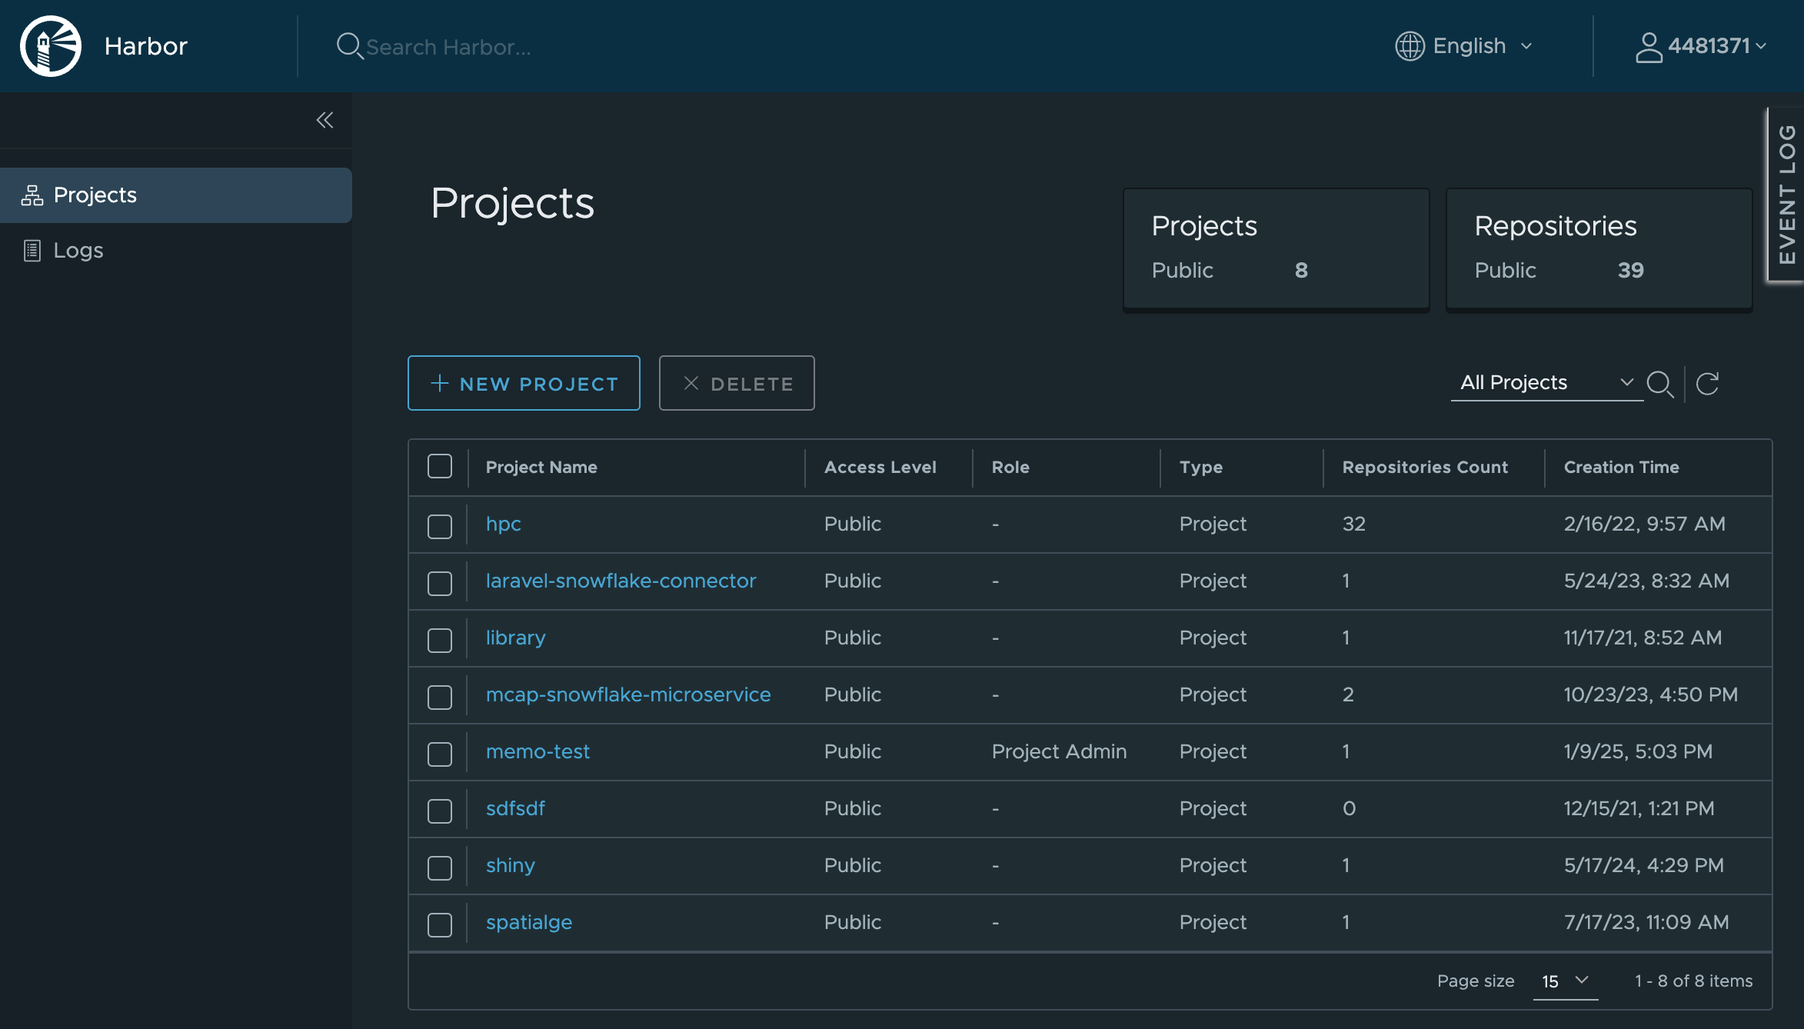
Harbor: Your resident Dockerhub
https://dockerhub.moffitt.org/

Slide 23
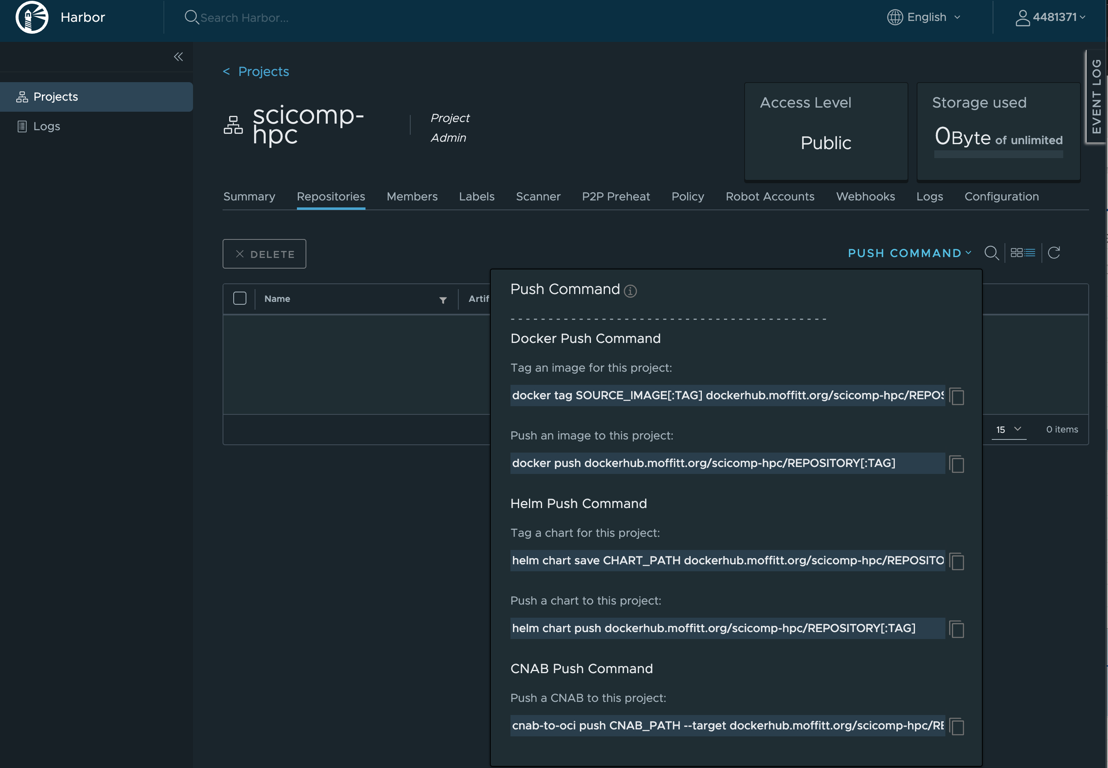
Harbor: Your resident Dockerhub

Slide 24
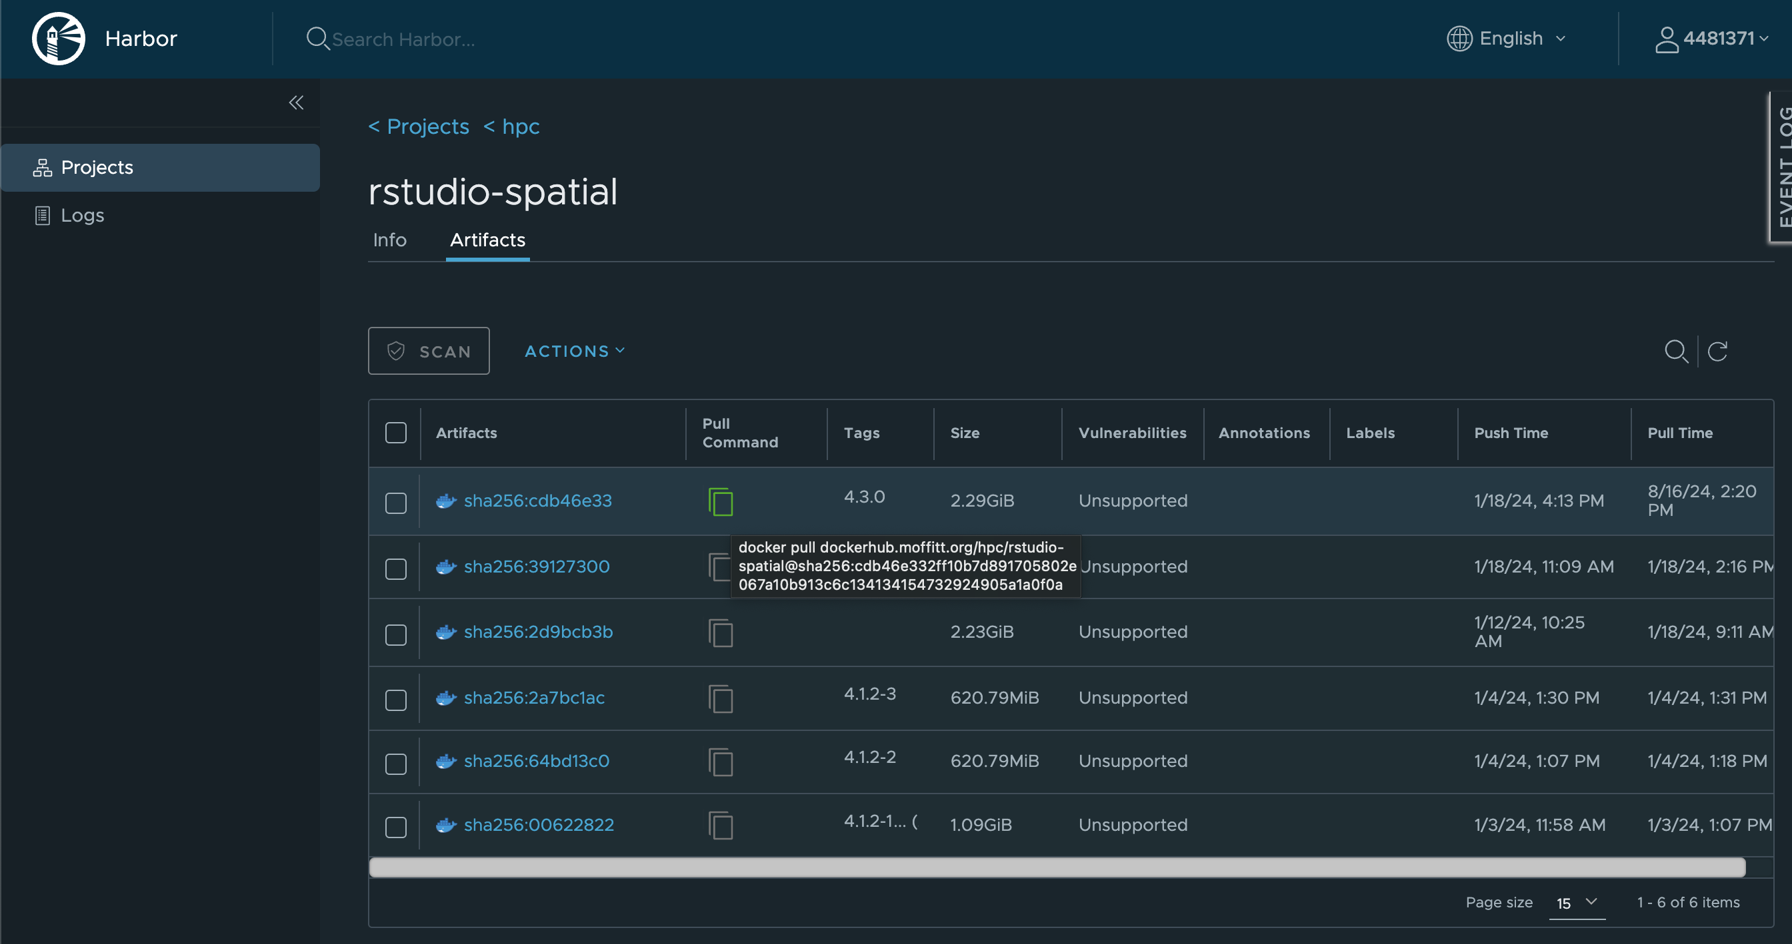
Harbor: Your resident Dockerhub

Slide 25
Demo: Running RStudio Using Containers
SSH to the login node
ssh <lawsonid>@red.moffitt.org
Grab a node (e.g. 4 cores with 40GB mem)
lawsonid@red1 ~]$ grabnode
How many CPUs/cores would you like to grab on the node? [1-64] 4
How much memory (1-1000GB) would you like to grab? [40] 40
Please enter the max number of days you would like to grab this node: [1-30] 1
Do you need a GPU ? [y/N] N
(… truncated)
Now connecting to node hpctpa3pc0041...
lawsonid@red-a41 ~]$ ← red-a41 is an alias for hpctpa3pc0041
Search for a Rstudio Server image
lawsonid@red-a41 ~]$ podman search rstudio
NAME DESCRIPTION
docker.io/rocker/tidyverse Version-stable build of R, rstudio, and R pa...
docker.io/rocker/rstudio RStudio Server image. ← Let’s use this
… (truncated)

Slide 26
Demo: Running RStudio Using Containers
Pull an Rstudio Server image
lawsonid@red-a41 ~]$ podman pull docker.io/rocker/rstudio
Trying to pull docker.io/rocker/rstudio:latest...
Getting image source signatures
Copying blob 6213efcac37a done
Copying blob 723d93f4c3a7 done
Copying blob 40cc9f7250e6 done
… (truncated)
Confirm pulled image
lawsonid@red-a41 ~]$ podman images
REPOSITORY TAG IMAGE ID CREATED SIZE
docker.io/rocker/rstudio latest d96a50ac4757 2 days ago 2.29 GB
Run the container!
lawsonid@red-a41 ~]$ podman run -e PASSWORD="my_password" -d --name my_rstudio-server --rm -v ${HOME}:/home/rstudio -p 8787:8787 d96a50ac4757
E65e2ac8ccc9f813a58deedba403f0f87d1ad98d01b5c5264e6416ade1a1ec9e
Confirm that the instance is running
lawsonid@red-a41 ~]$ podman ps
CONTAINER ID IMAGE COMMAND CREATED STATUS PORTS NAMES
e65e2ac8ccc9 docker.io/rocker/rstudio:latest /init About a minute ago Up About a minute ago 0.0.0.0:8787->8787/tcp my_rstudio-server

Slide 27
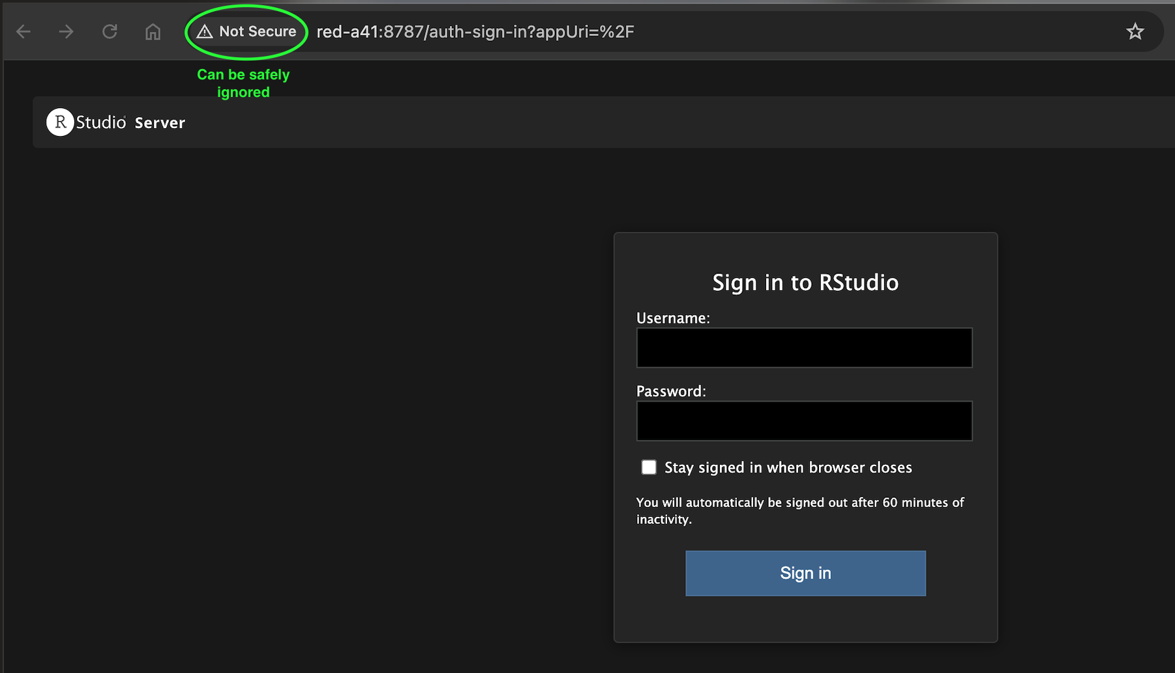
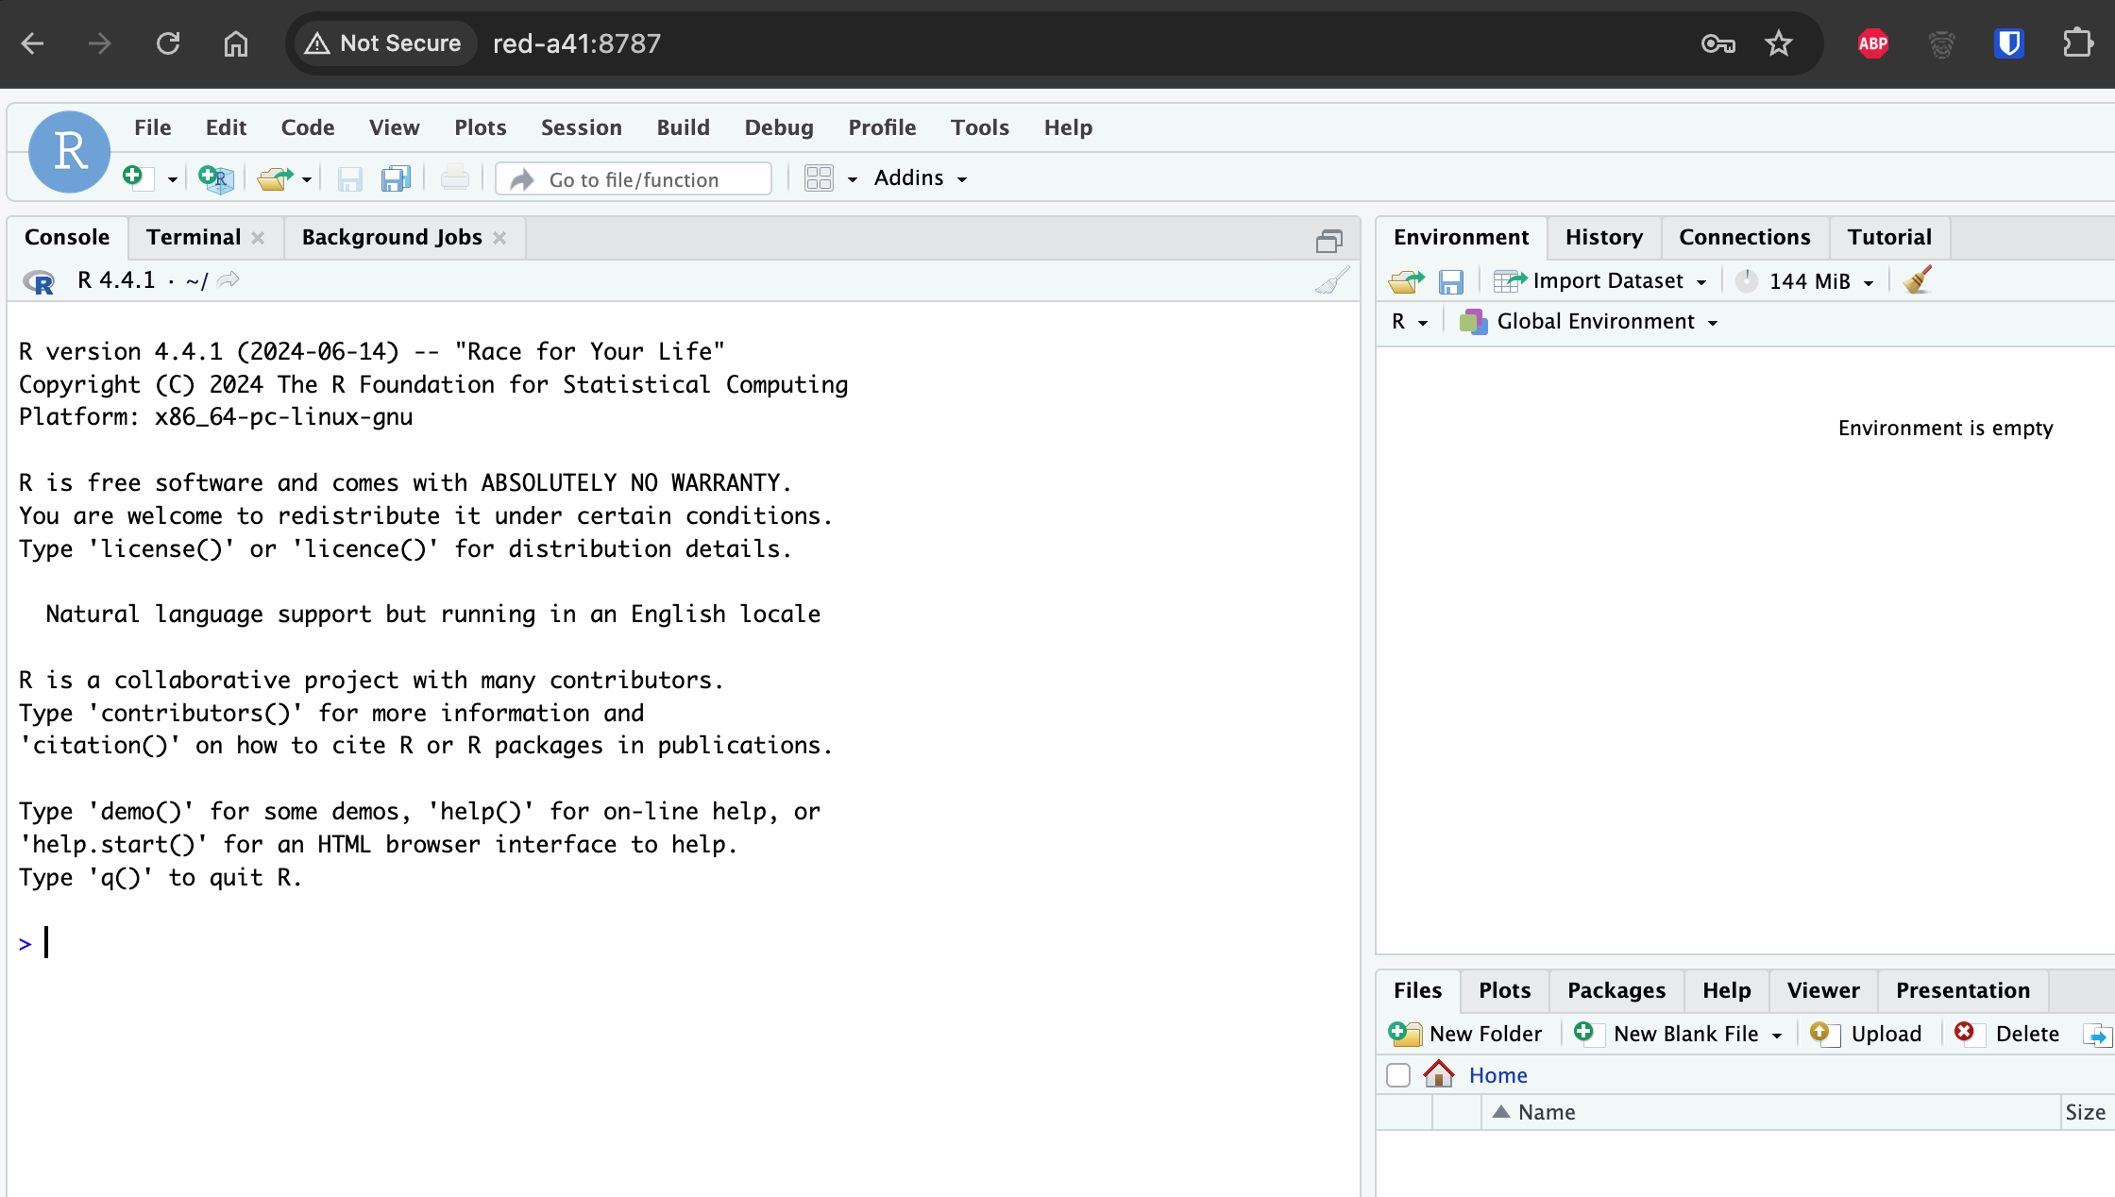
Demo: Running RStudio Using Containers
Open a browser window (using any system inside the Moffitt Network or VPN)
Visit http://<compute_node_hostname>:8787 (In our case http://red-a41:8787)
Login as:
Username: root
Password: my_password ← Use what you provided in: podman -e PASSWORD=“my_password” …
Congratulations! You are now running the Rstudio.
Remember: Containers are local to nodes running them. They won’t exist on other nodes.
…and ENJOY! 🥳

Slide 28
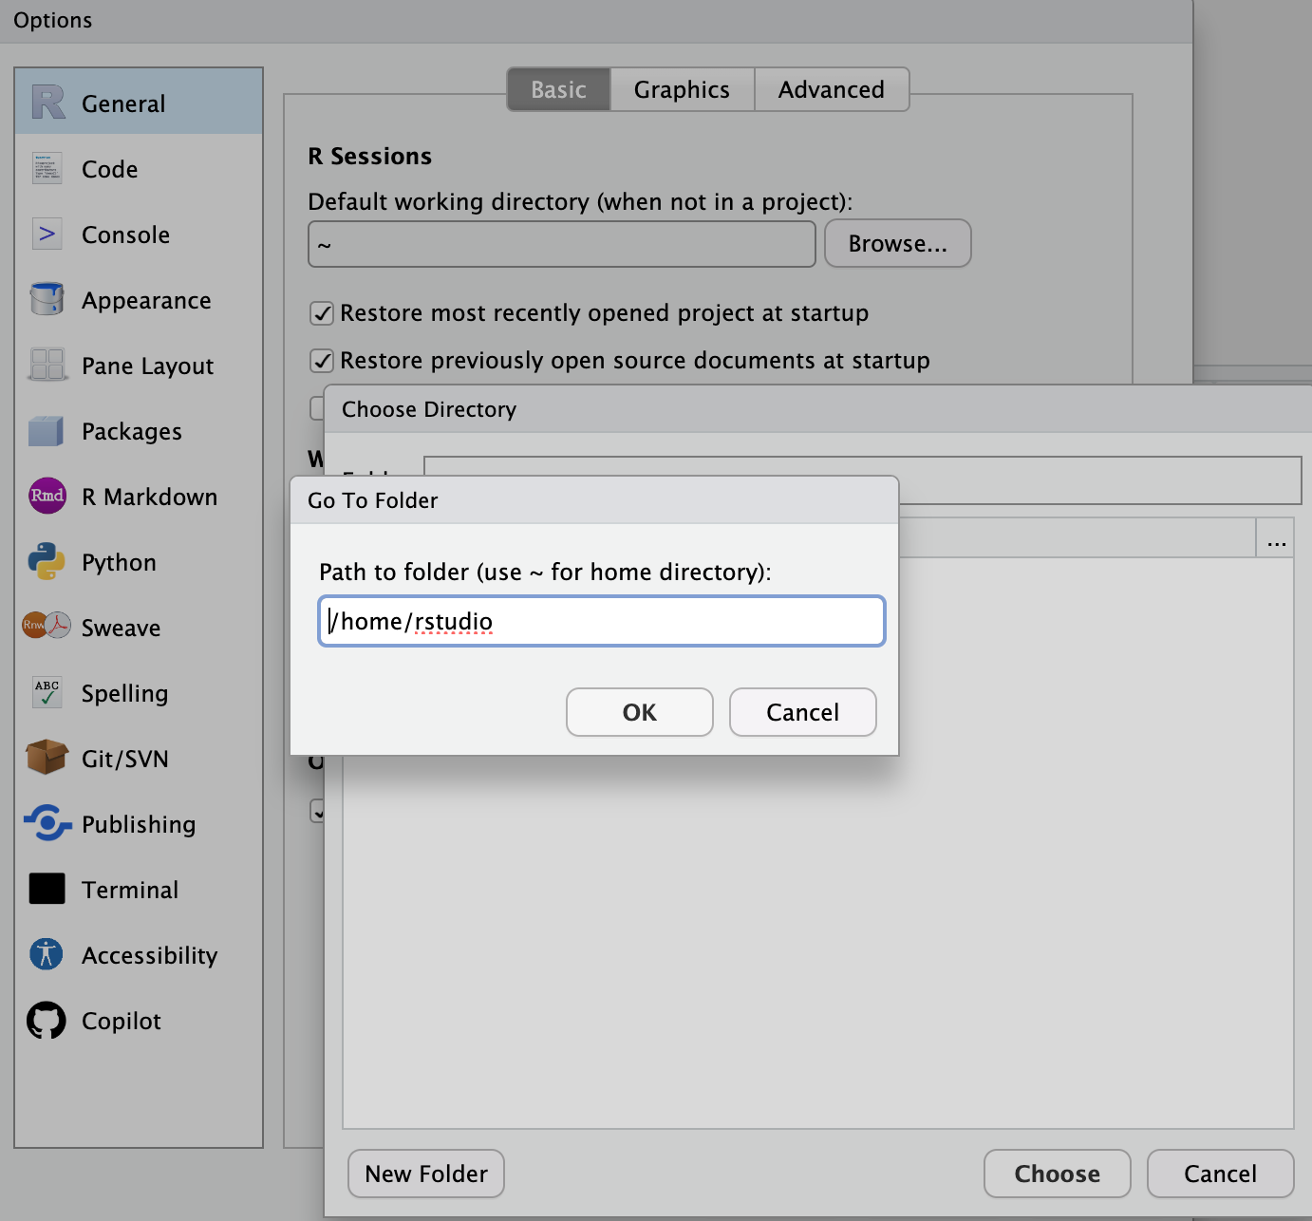
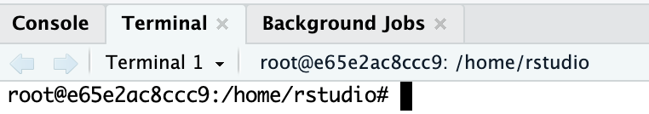
Demo: Running RStudio Using Containers
Useful Tips:
Choose a good/unique password. Remember, anyone in the Moffitt Network can now see your instance.
Change default home directory as /home/rstudio. You can do the same for Default open project location
Global Options → General → Basic → Default working directory
Global Options → General → Advanced → Default open project directory
You can use the Terminal tab to run commands or install missing R packages
If the forwarded port is already in use (e.g. another user on the same node), pick another one (e.g. -p 8788:8787)
click here

Slide 29
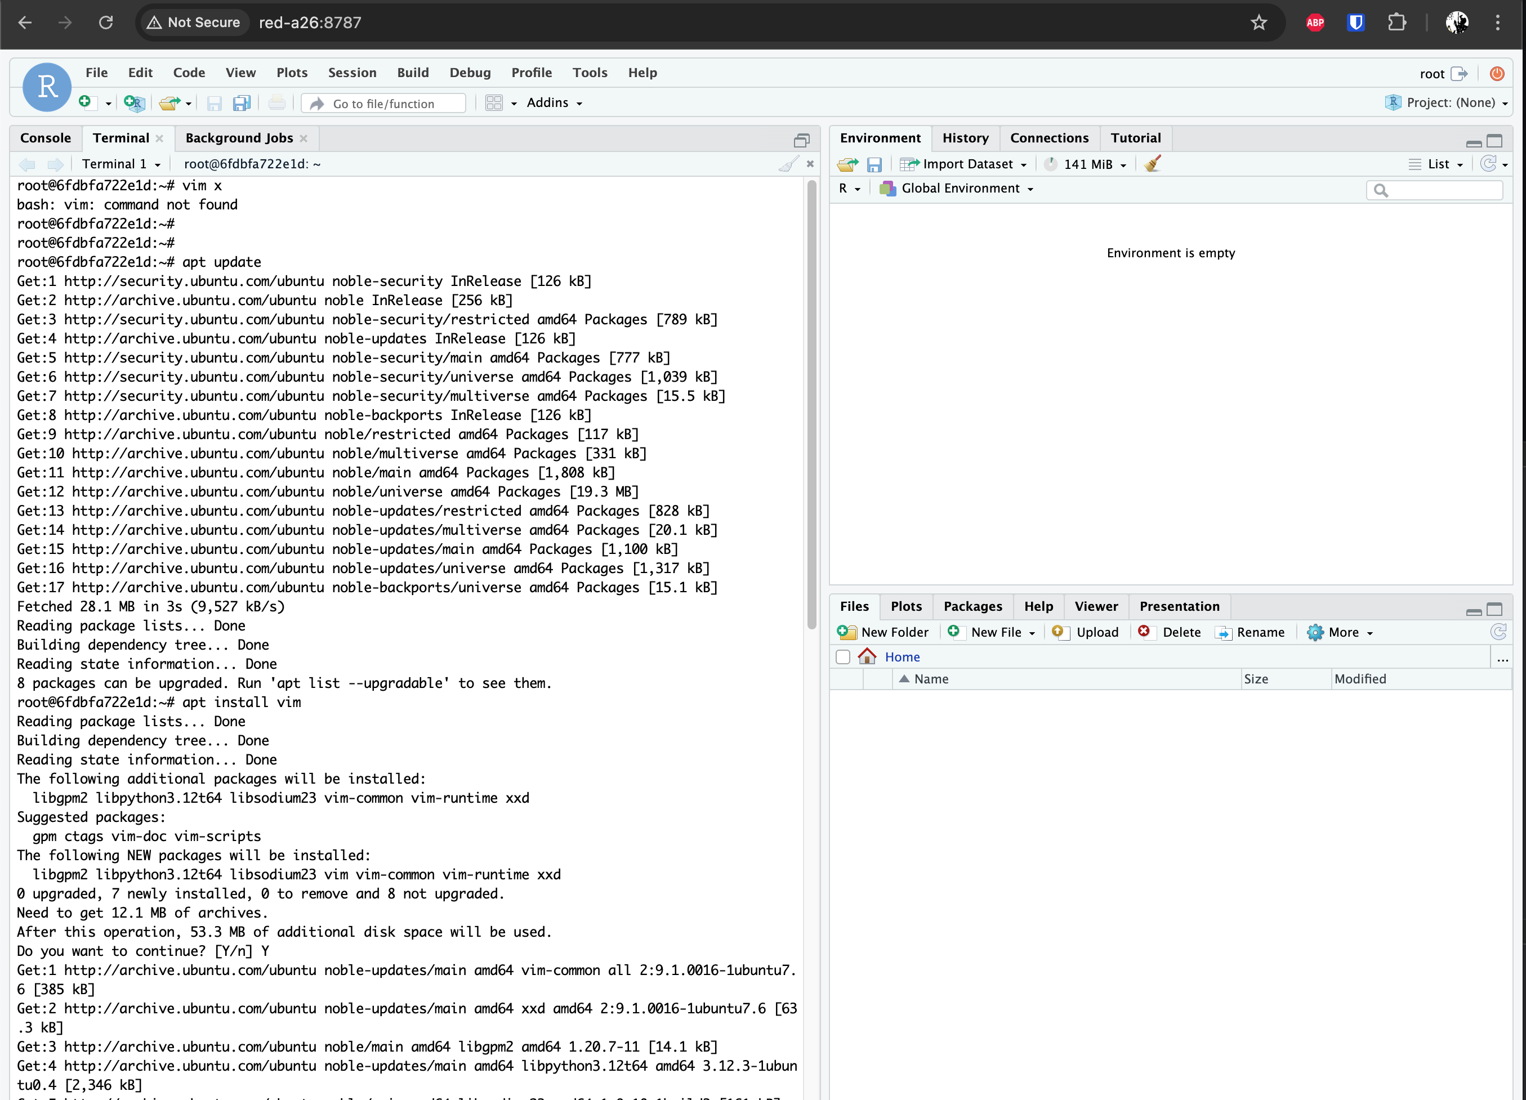
Demo: Running RStudio Using Containers
Let’s make this container our own!! E.g. Install VIM (or whatever you like)
At this point, we’ve changed this container
Changes will be lost when we terminate this instance
So let’s turn it into a new image and push it to Moffit’s DockerHub (Harbor)
Make it public if needed – so others can also benefit from it

Slide 30
Demo: Running RStudio Using Containers
Commit the modified container as a new image
$ podman ps
CONTAINER ID IMAGE COMMAND CREATED STATUS PORTS NAMES
6fdbfa722e1d docker.io/rocker/rstudio:latest /init 24 seconds ago Up 25 seconds ago 0.0.0.0:8787->8787/tcp my_rstudio-server
$ podman commit 6fdbfa722e1d my_modified_rstudio_server:latest
$ podman images
REPOSITORY TAG IMAGE ID CREATED SIZE
localhost/my_modified_rstudio_server latest 104c309e06c1 About a minute ago 2.47 GB
docker.io/rocker/rstudio latest 5669edbdbcbf 4 hours ago 2.37 GB
Login to Moffitt’s Harbor
$ podman login dockerhub.moffitt.org
Username: your_moffitt_id
Password: your_moffitt_password
Login Succeeded!
Tag & Push
$podman tag localhost/my_modified_rstudio_server:latest dockerhub.moffitt.org/scicomp-hpc/my_modified_rstudio_server:latest
$podman push dockerhub.moffitt.org/scicomp-hpc/my_modified_rstudio_server:latest

Slide 31
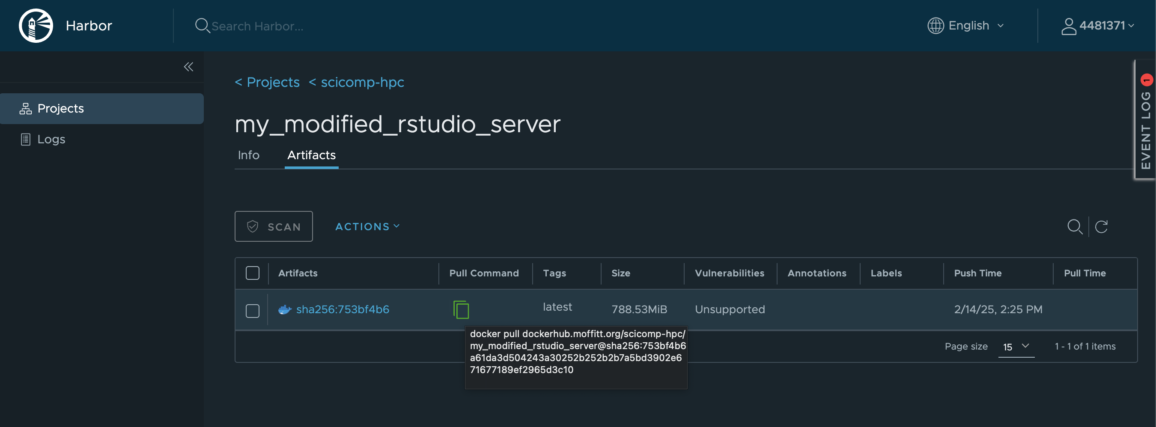
Demo: Running RStudio Using Containers
... On a different node (or your lab machine)
Login to harbor (see previous slide)
Pull your modified container using the “Pull Command” provided in the Harbor interface
$ podman pull dockerhub.moffitt.org/scicomp-hpc/my_modified_rstudio_server@sha256:753bf4b6a61da...(truncated)
$ podman images
REPOSITORY TAG IMAGE ID CREATED SIZE
dockerhub.moffitt.org/scicomp-hpc/my_modified_rstudio_server <none> 104c309e06c1 15 minutes ago 2.47 GB

Slide 32
Demo: Running RStudio Using Containers
Another option: Containers can be “files” if you want them to be!
$ podman ps
CONTAINER ID IMAGE COMMAND CREATED STATUS PORTS NAMES
c455cf0f2a09 d96a50ac4757 /init 11 minutes ago Up 11 minutes ago 0.0.0.0:8787->8787/tcp my_rstudio-server
$ podman commit c455cf0f2a09 my_modified_rstudio_server
$ podman images
REPOSITORY TAG IMAGE ID CREATED SIZE
localhost/my_modified_rstudio_server latest b182584cae95 2 minutes ago 2.29 GB
$ podman save -o my_modified_rstudio_image.tar localhost/my_modified_rstudio_server
On any other node:
$ podman load -i my_modified_rstudio_image.tar

Slide 33
Thanks!
Your feedback is crucial for us to shape Open OnDemand and Containers at Moffitt to provide the best possible experience, ensuring it meets the unique needs of our organization and enhances productivity.
Please reach out to us anytime for any issues/suggestions you may have!

